Slide 1
Sustainability Heroes grow and preserve their own food—If I can do it, you can do it
. . .and here’s how

Slide 2
2017 Raised Beds
Photos taken 4/18/17
(unless noted otherwise)

Slide 3
Why Raised Bed Gardening?
Soil in Willamette Valley is difficult clay
Control soil, possible to just use compost

Slide 4
Why Raised Bed Gardening?
Soil in Willamette Valley is difficult clay
Control soil, possible to just use compost
Reduce Water—don’t water weeds

Slide 5
Why Raised Bed Gardening?
Soil in Willamette Valley is difficult clay
Control soil, possible to just use compost
Reduce Water—don’t water weeds
Plant Densely—save space, fewer weeds

Slide 6
What to grow?
Corvallis is ridiculously easy to grow your own food
Carrots, onions, leeks, cucumbers, beans, tomatoes, tomatillos, parsnips, potatoes, garlic, peas, sweet potatoes, regular potatoes, squash—summer and winter, cantaloupe, salad greens. Just about anything.

Slide 7
Grow stuff close together
Raised Beds allow you to plant densely, because there is clearing all around

Slide 8
Grow stuff close together
Raised Beds allow you to plant densely, because there is clearing all around
Drip tape puts water only on desired plants.

Slide 9
Grow stuff close together
Raised Beds allow you to plant densely, because there is clearing all around
Drip tape puts water only on desired plants.
Combined, these nearly eliminate weeds in the beds.

Slide 10
Plant stuff for winter harvest
Carrots & Cabbage mid-July
Peas, Beets, Spinach October
Salad Greens & Chard—most anytime
Garlic—Halloween Time
Onions—Fall varieties in September; Spring varieties in February-March
Leeks—Most anytime (they overwinter well)

Slide 11
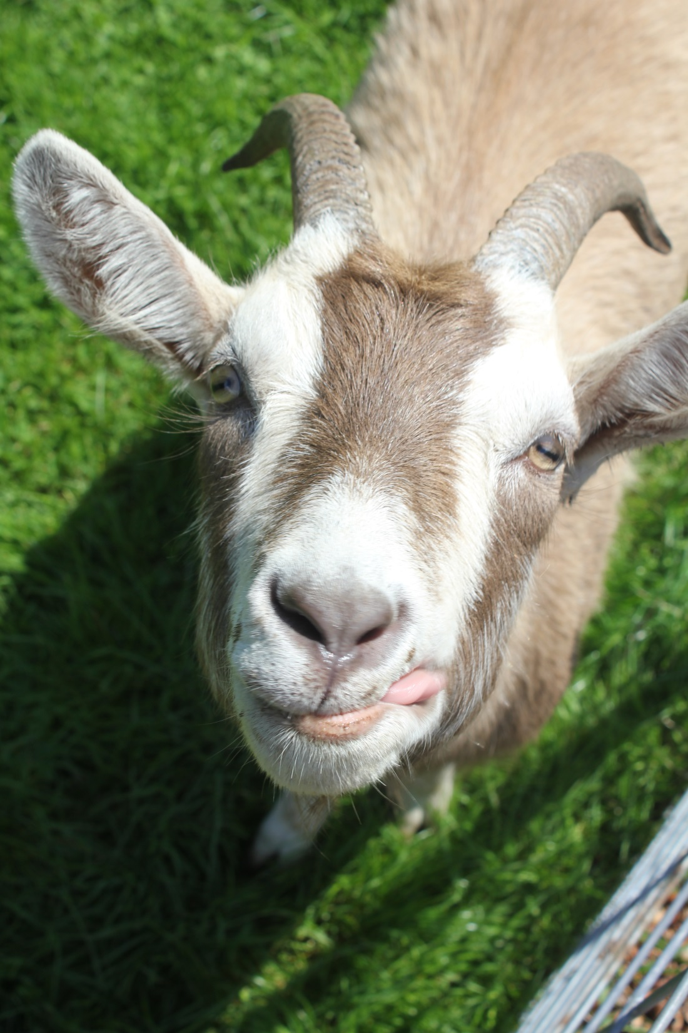
Stanley always
wants to be
involved in any
project. “can I
help, Steve?
Please!!!! Help
me over the fence
I won’t eat all
of your garden
---promise!” (as
you can see,
tongue deeply
embedded in
cheek)

Slide 12
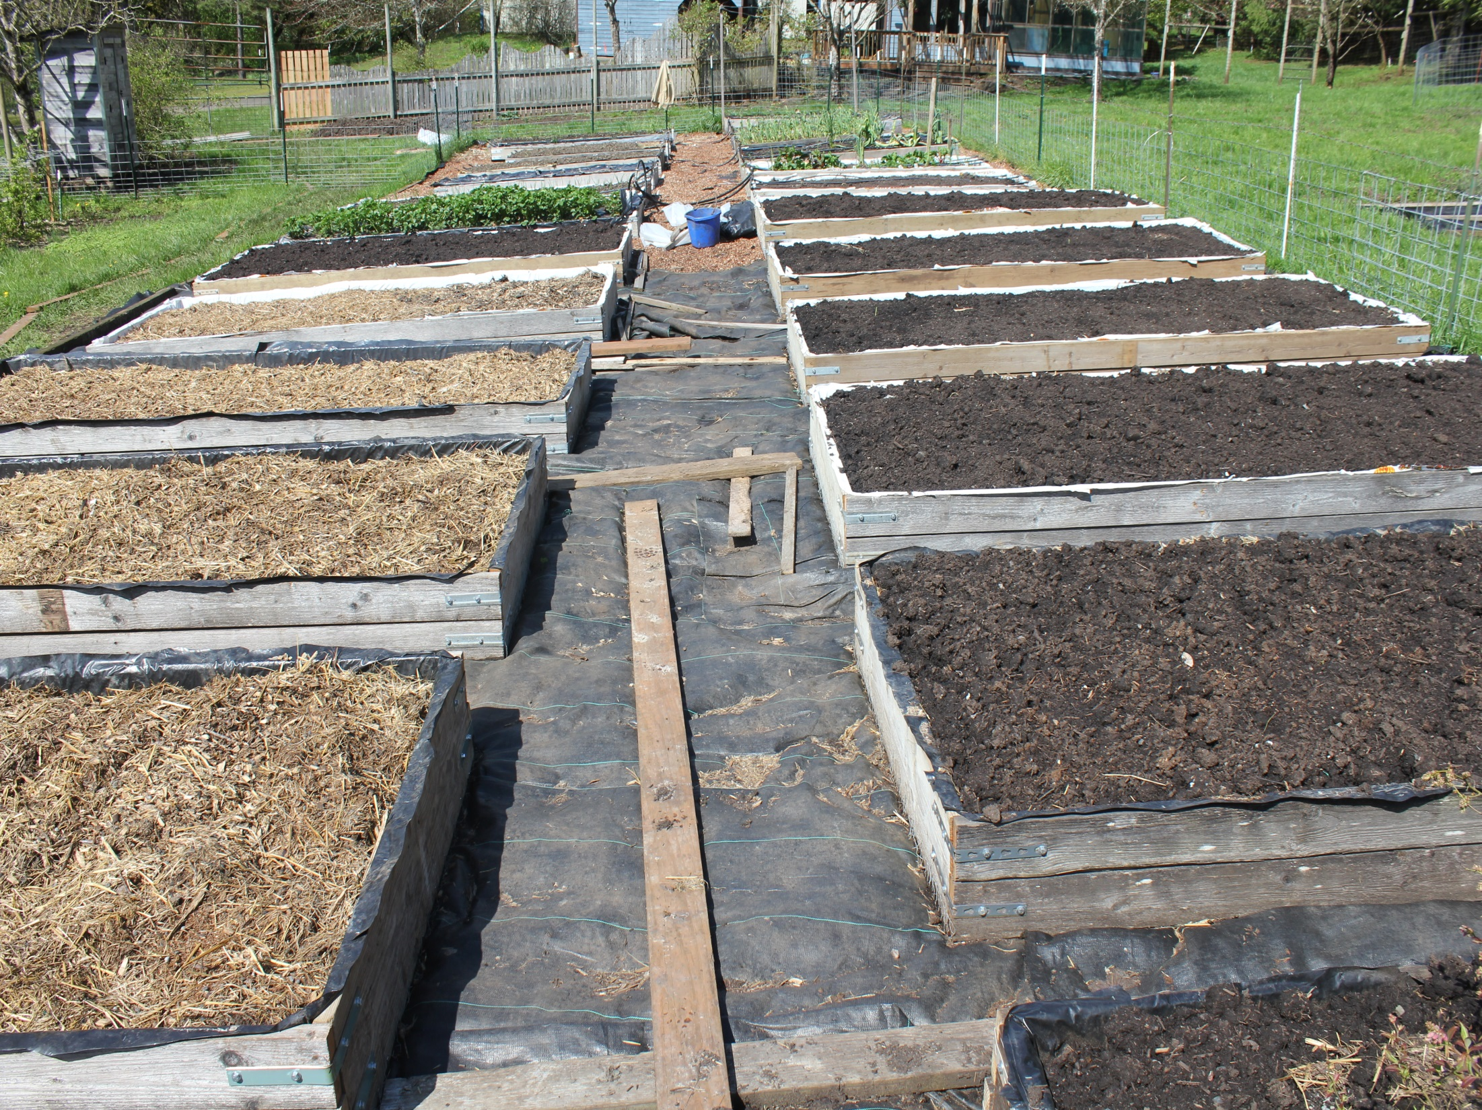
My garden has
25 beds about 5 ‘X 12’
(used fir 2X6 & 2X12
with poly liner)
Put down landscape
fabric to cover grass
chicken wire under bed
to exclude gophers/moles
layer of mulch, layer of soil
mix, layer of manure/straw,
layer of compost

Slide 13
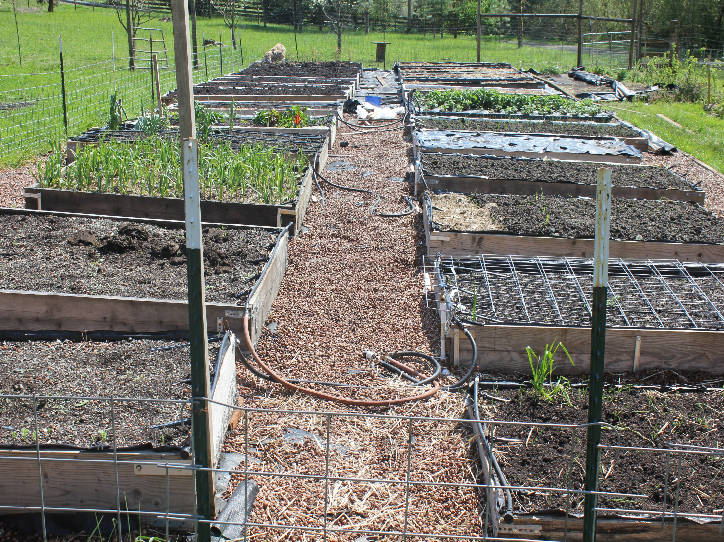
Hazelnut shells for better footing
on landscape fabric
(and aesthetics)

Slide 14
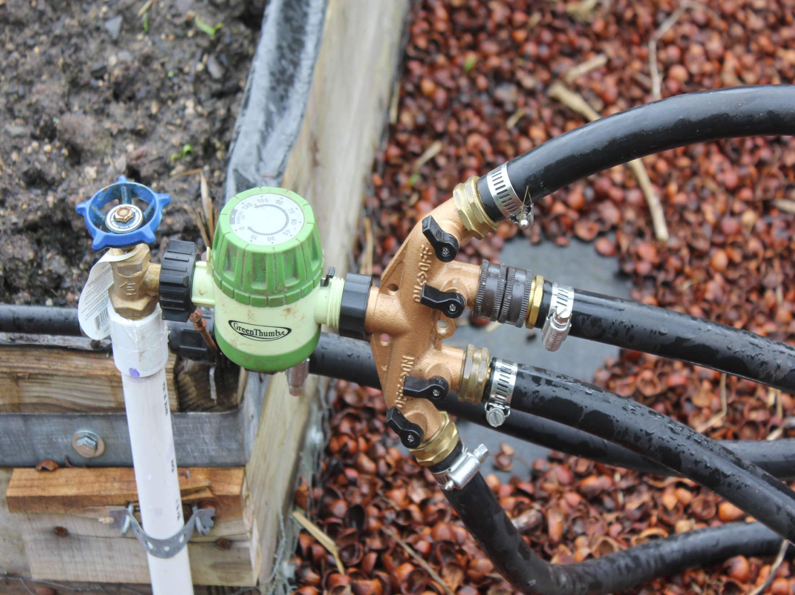
Standpipe, timer, manifold,
hoses to four raised beds.
1-2 hours per day waters
everything.

Slide 15
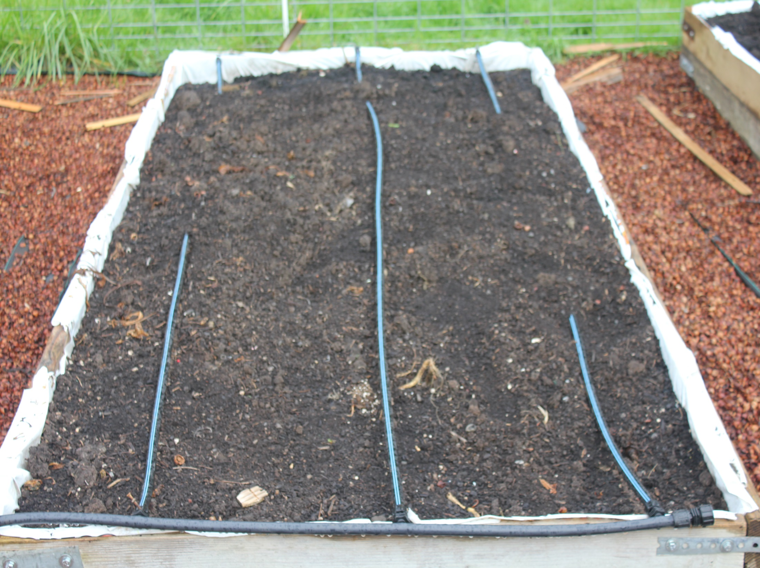
Drip Tape-drips every eight inches
I often plant a double row straddling
the drip tapes (carrots for example)

Slide 16
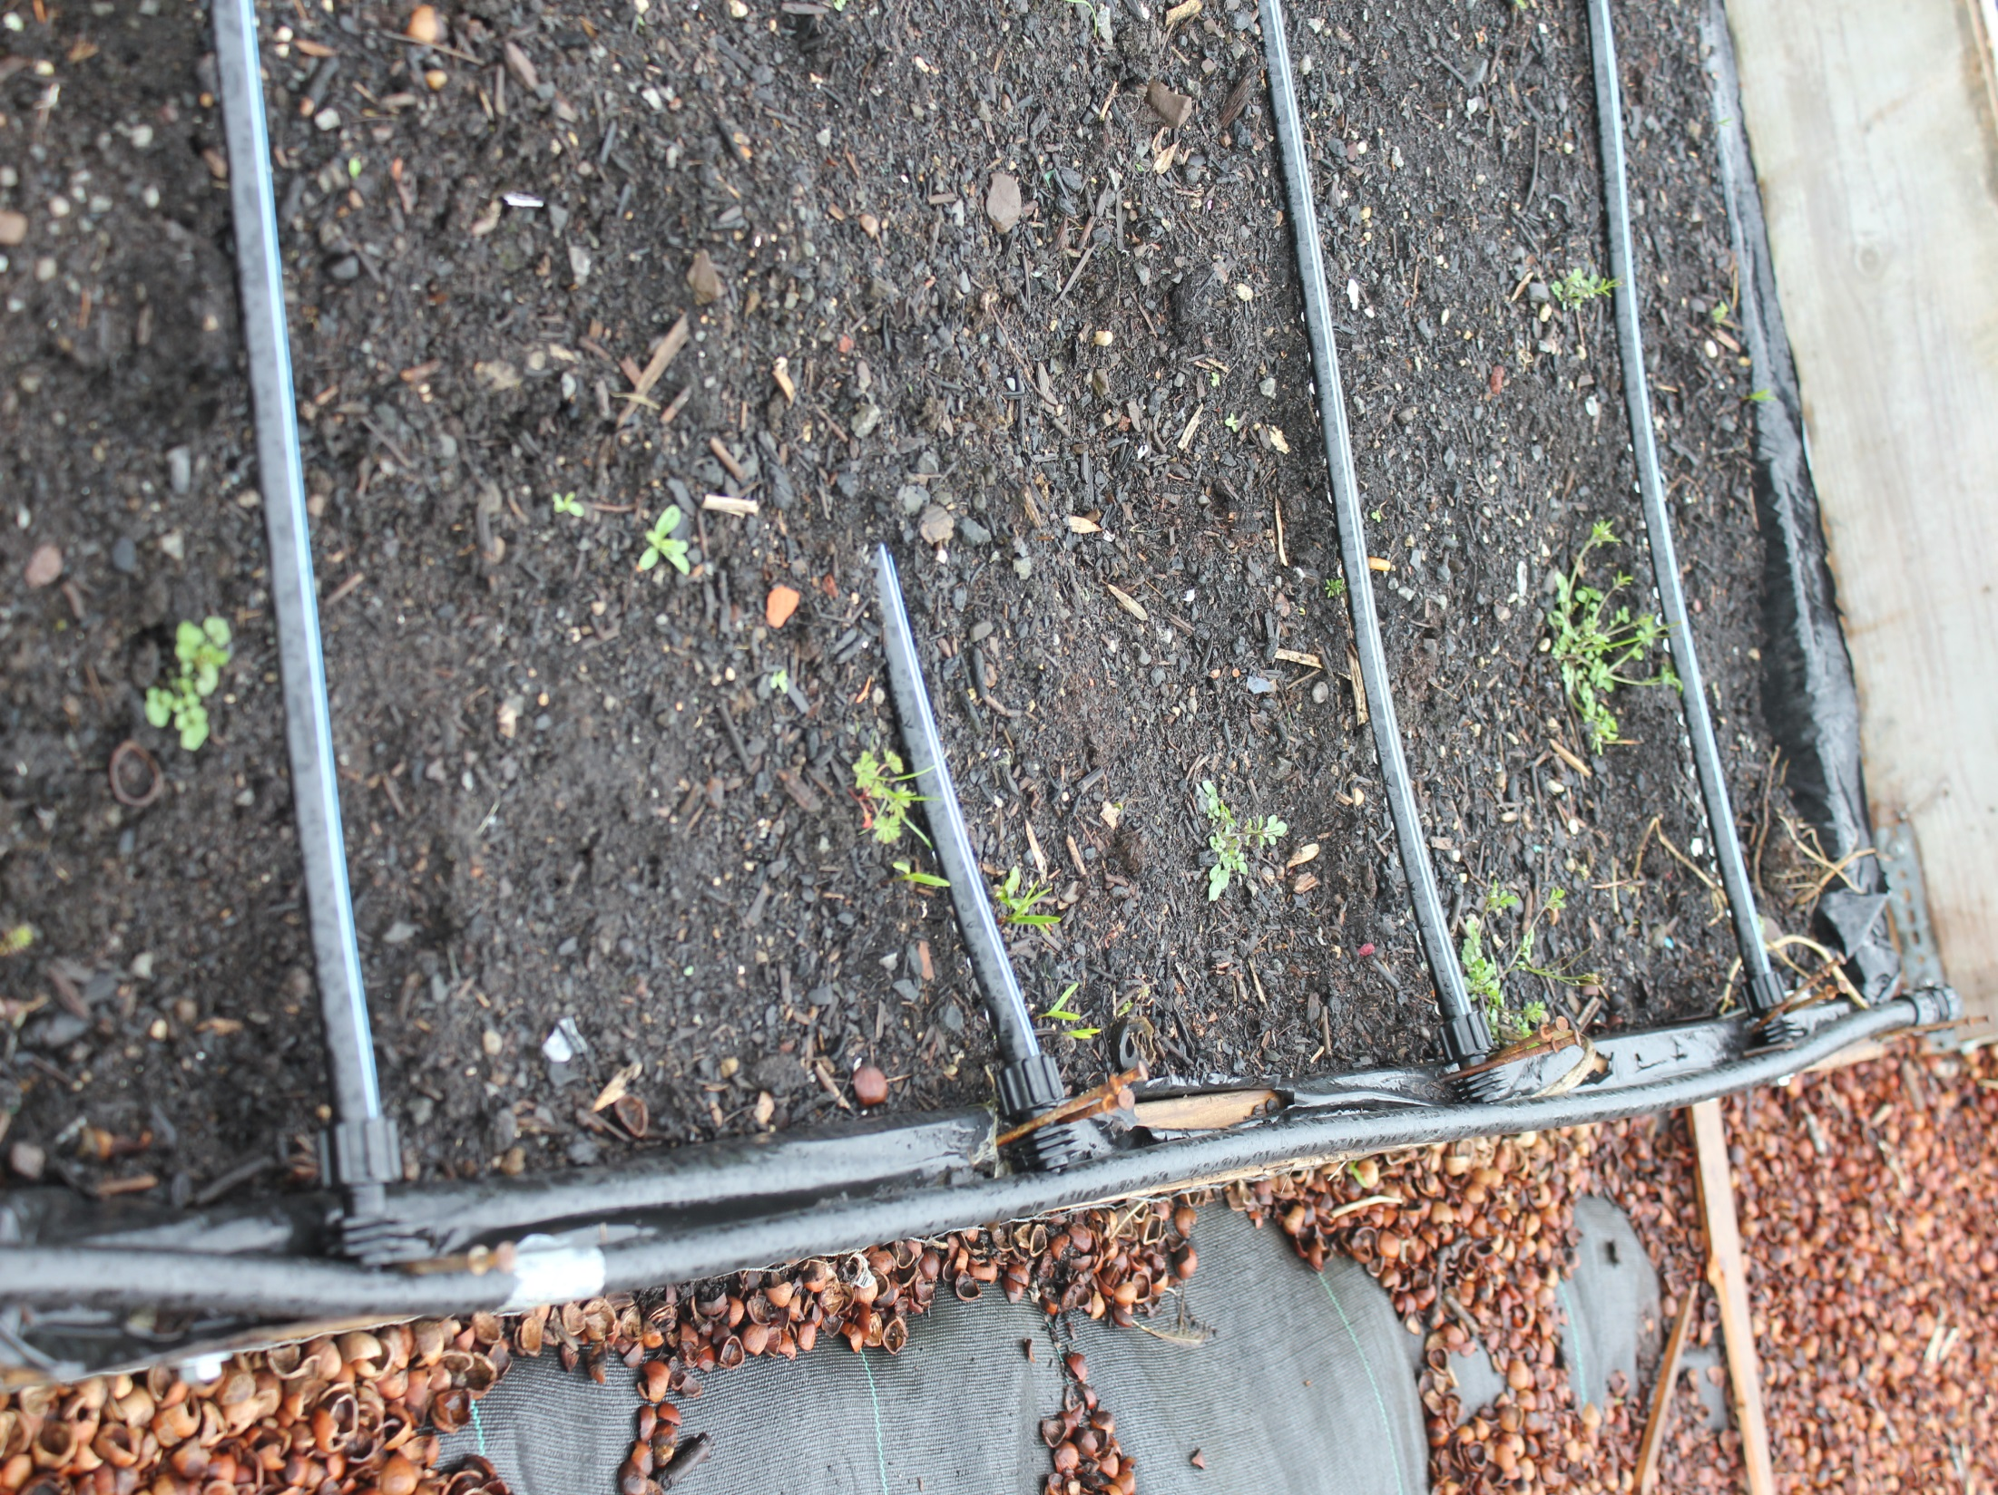

Slide 17
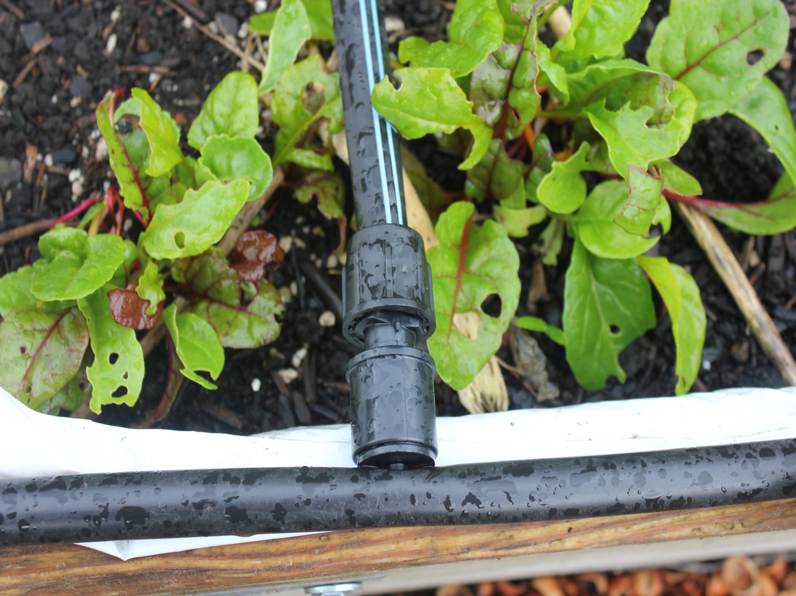

Slide 18
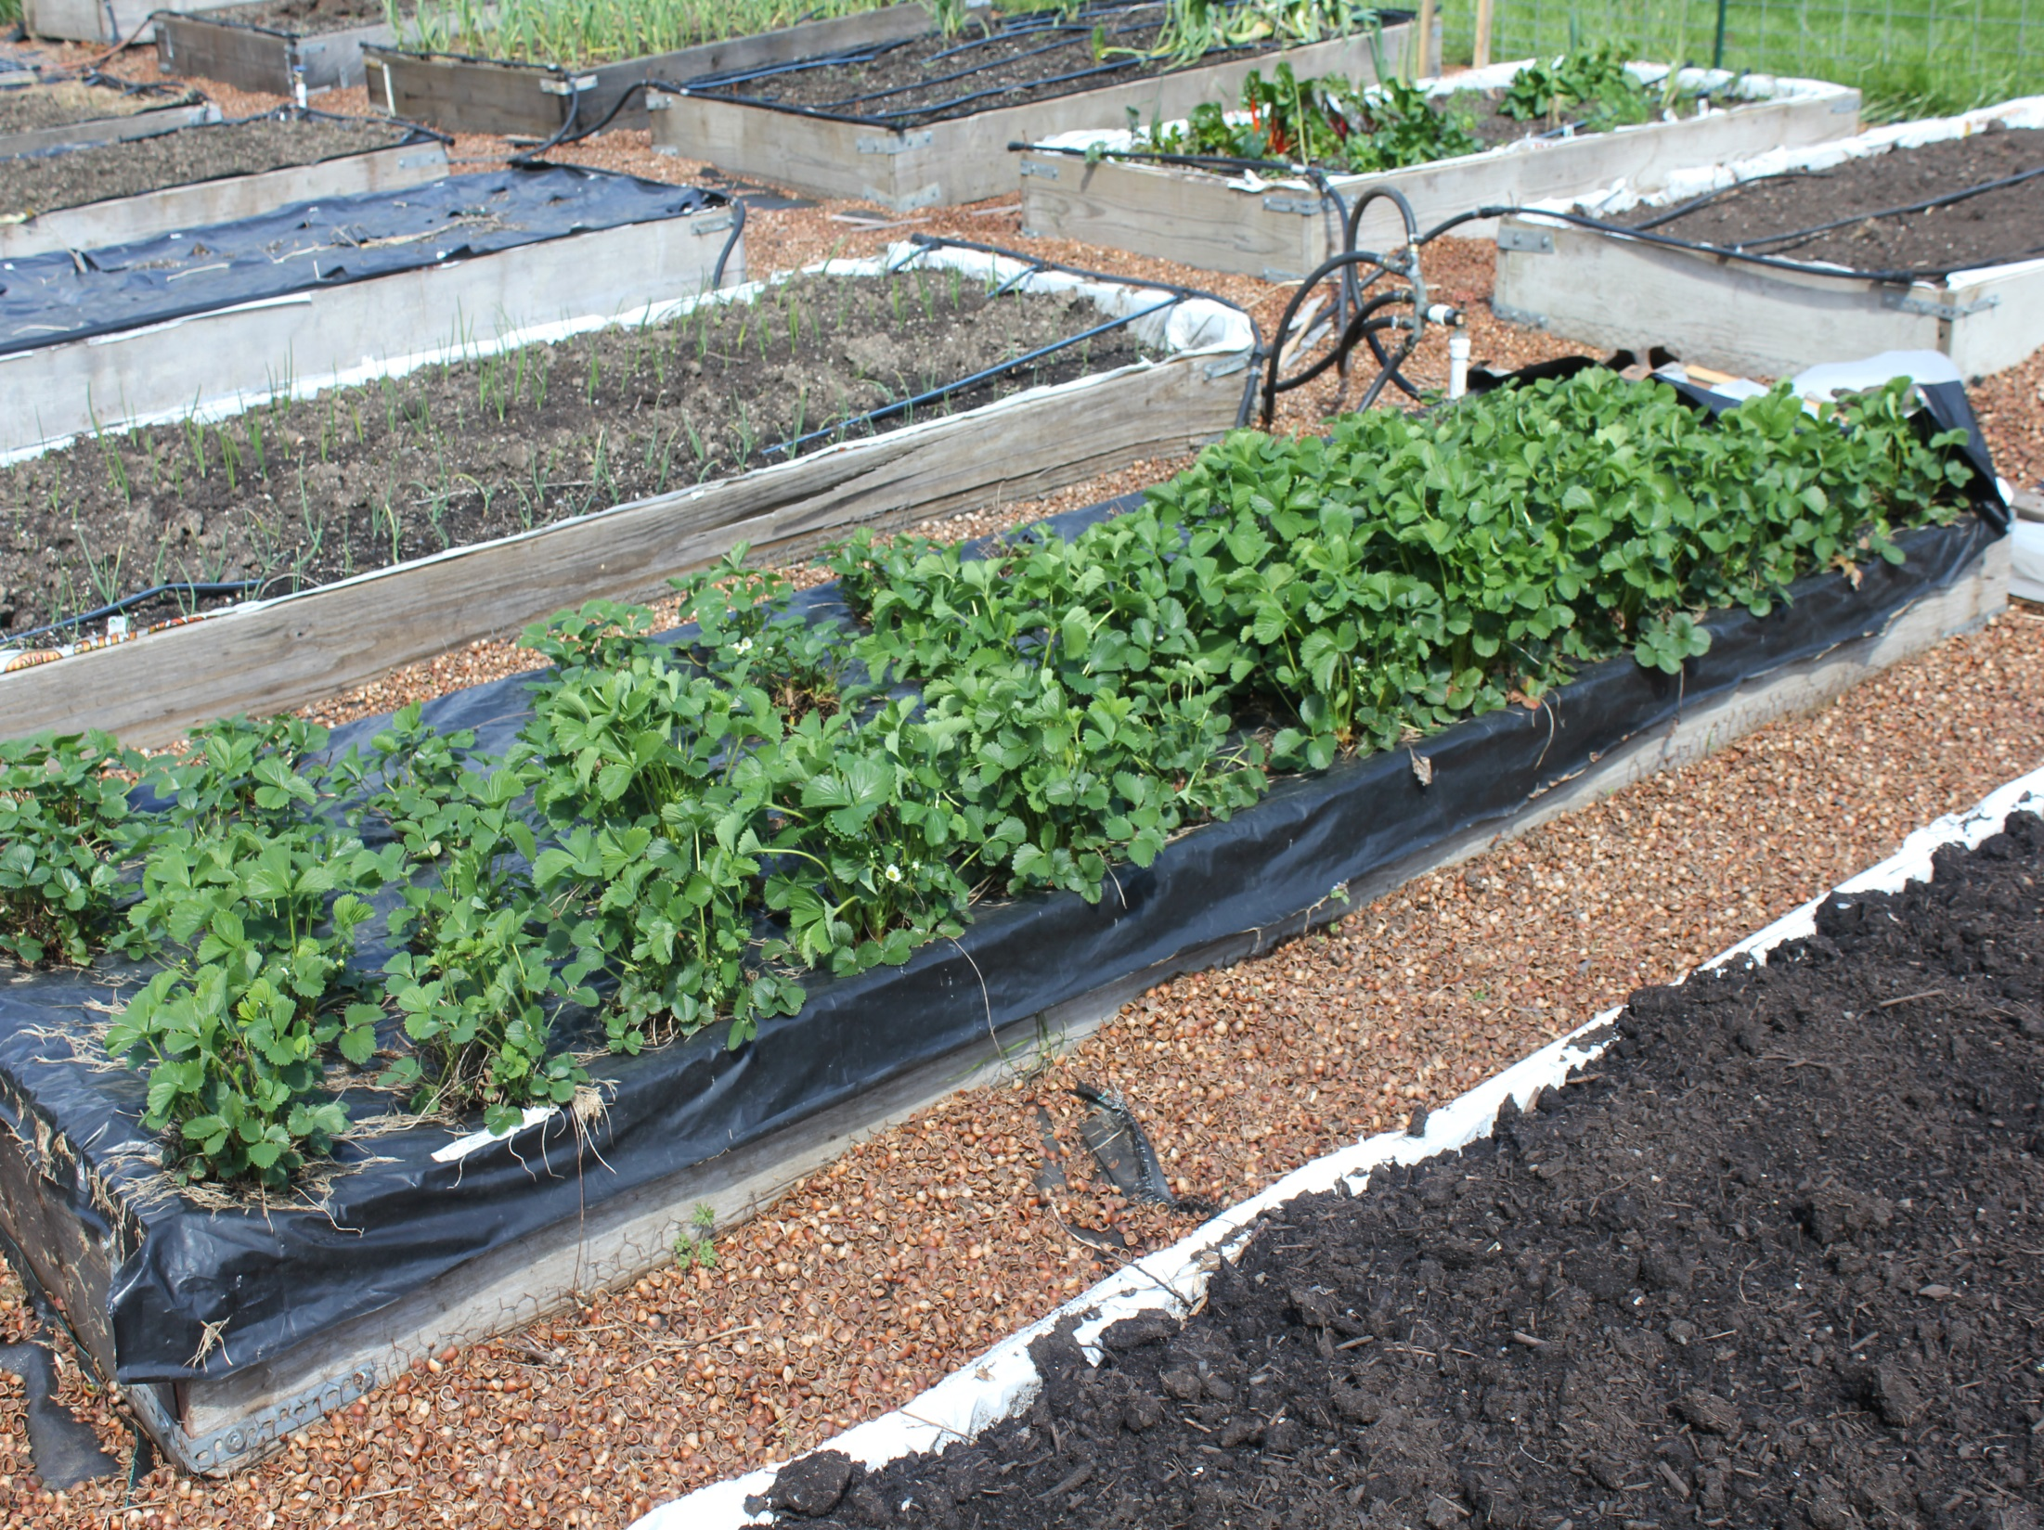
Strawberries planted 2016. This bed produced six
gallons sliced berries in 2017. Note plastic mulch
keeps runners from rooting

Slide 19
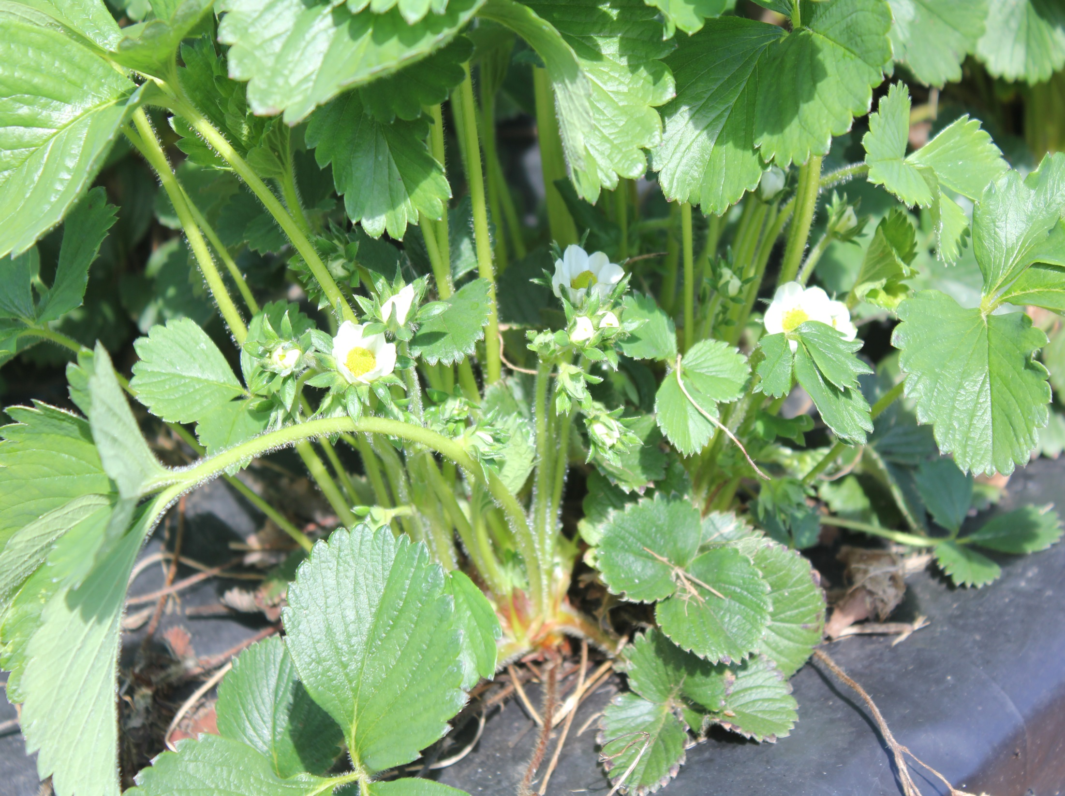

Slide 20
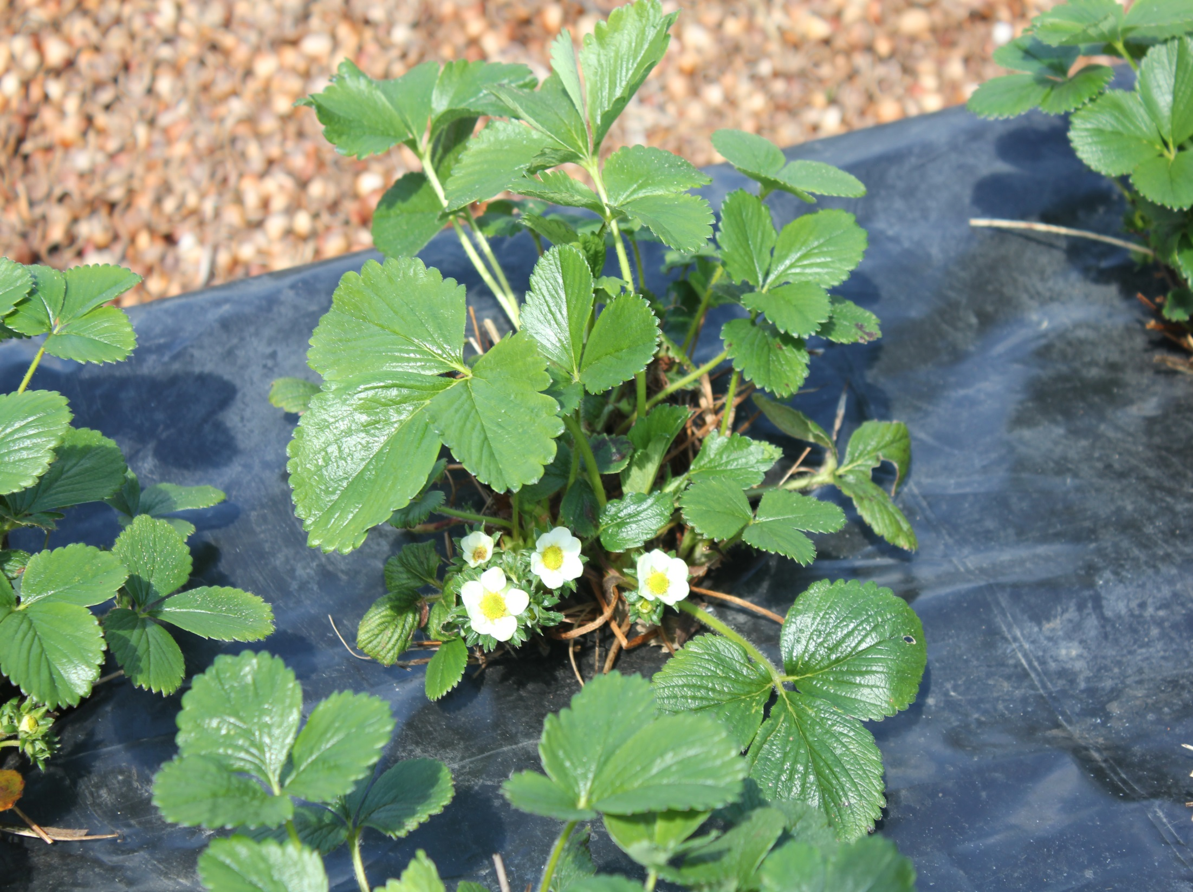

Slide 21
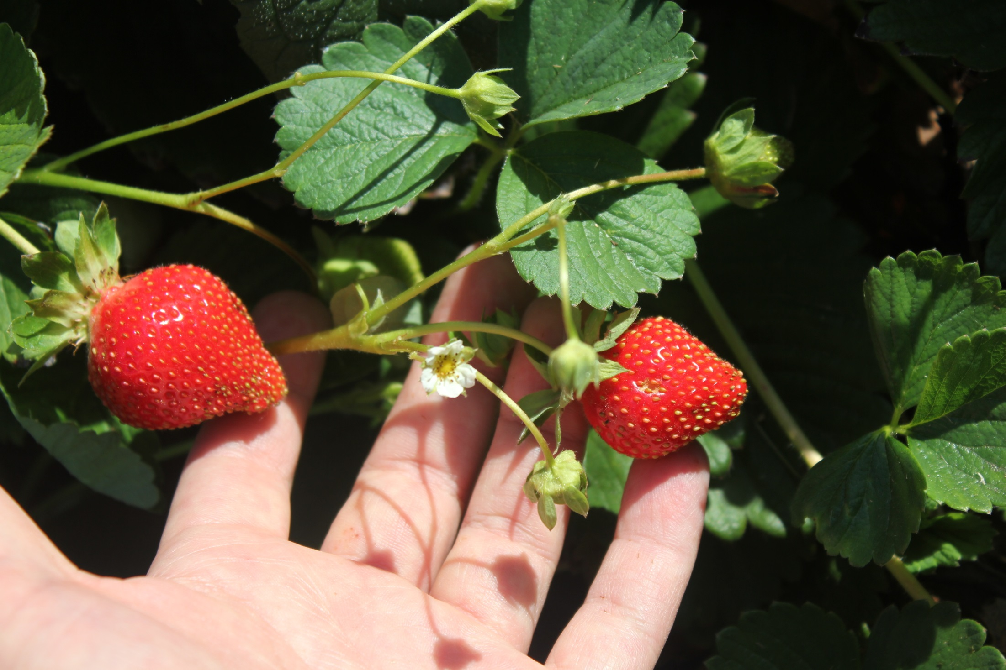

Slide 22
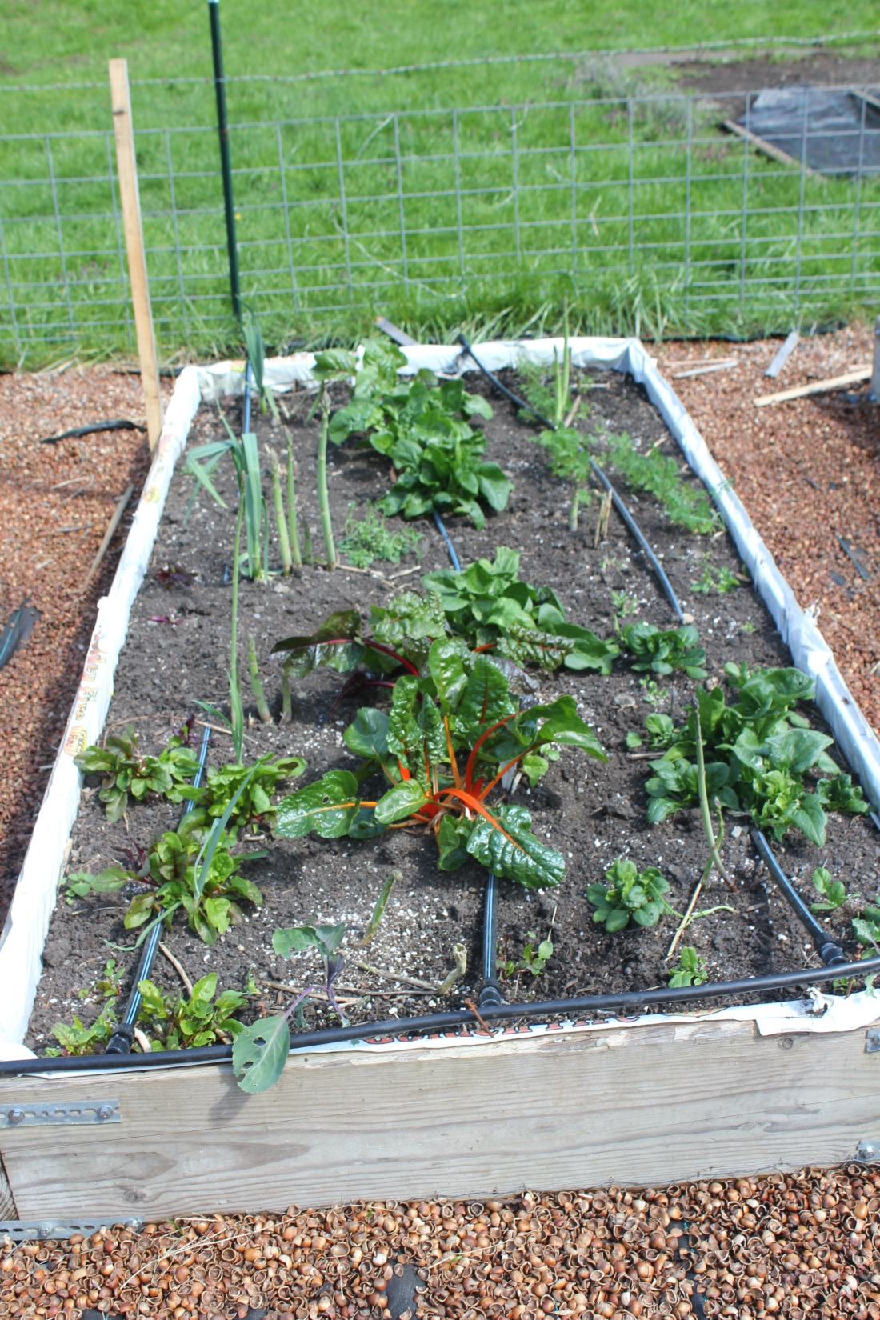
Swiss Chard
overwinters well.
Note:
asparagus—takes
three years to
produce (for me
quantity is not
worth the effort)

Slide 23
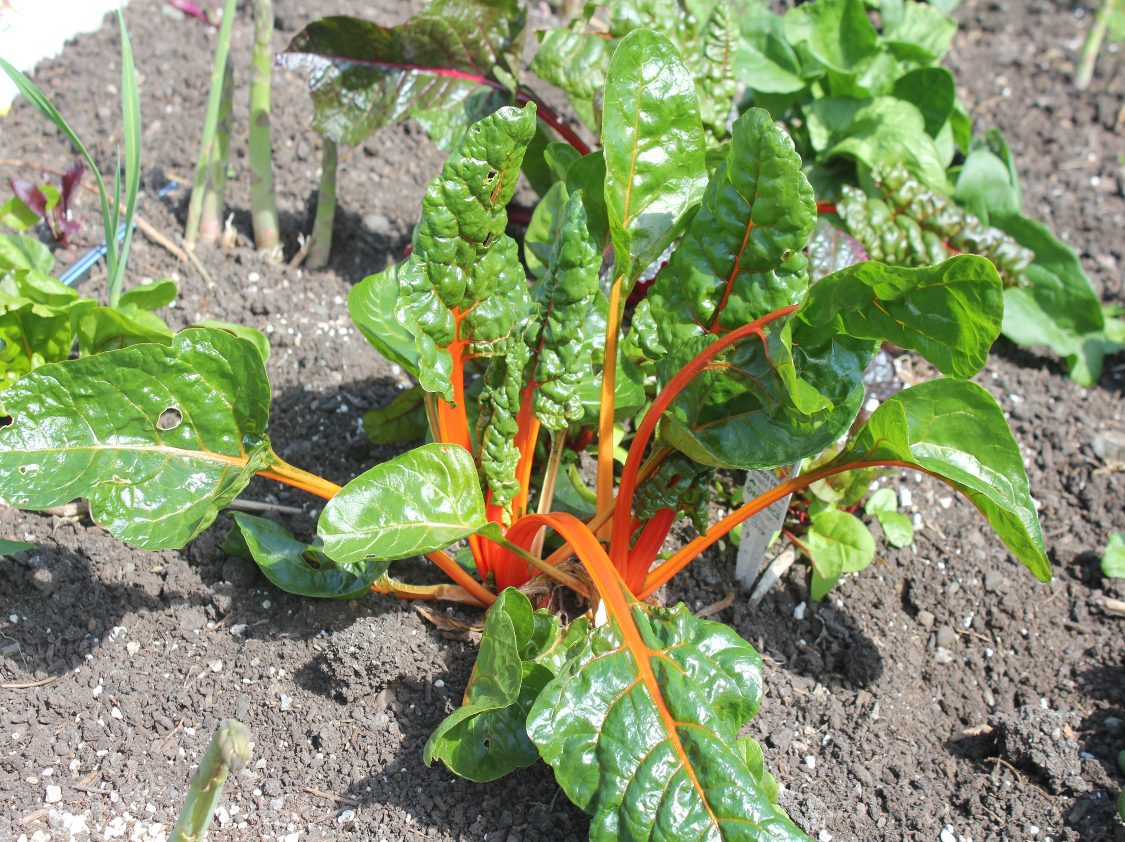
“OverwinteredSwiss Chard

Slide 24
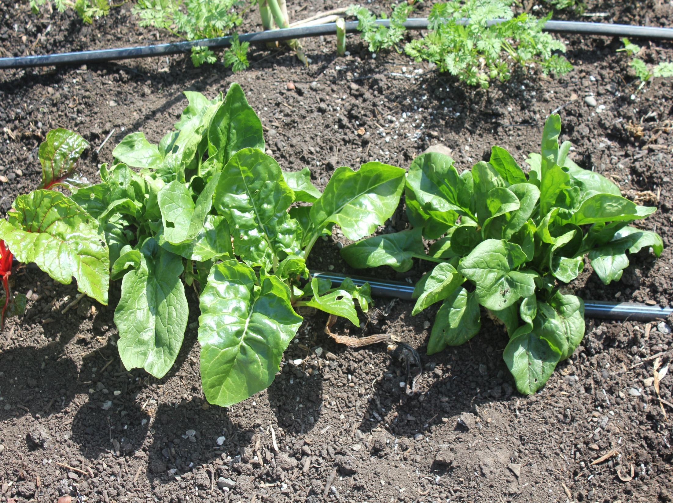
Fall Spinach planting

Slide 25
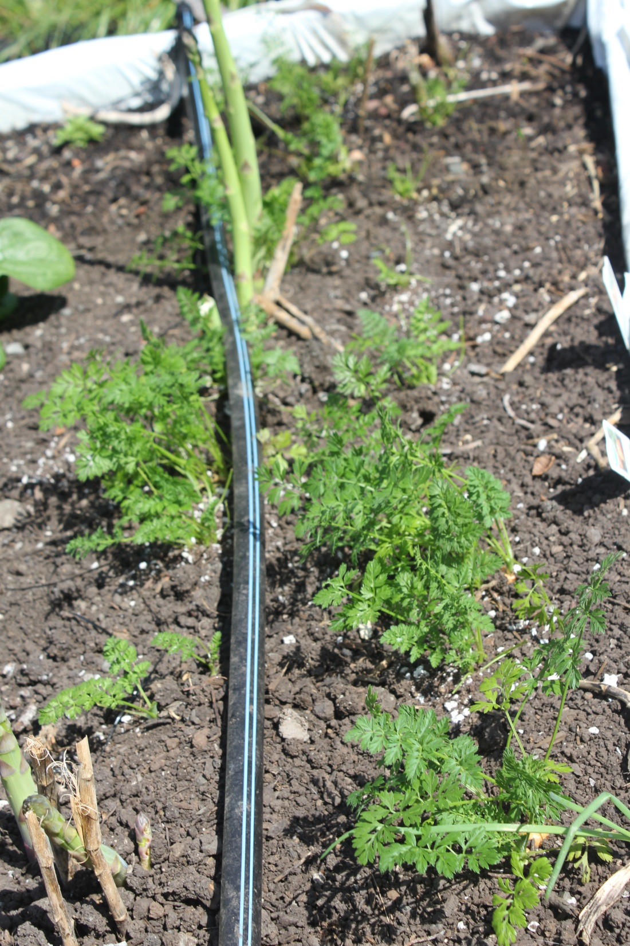
March carrot
transplants

Slide 26
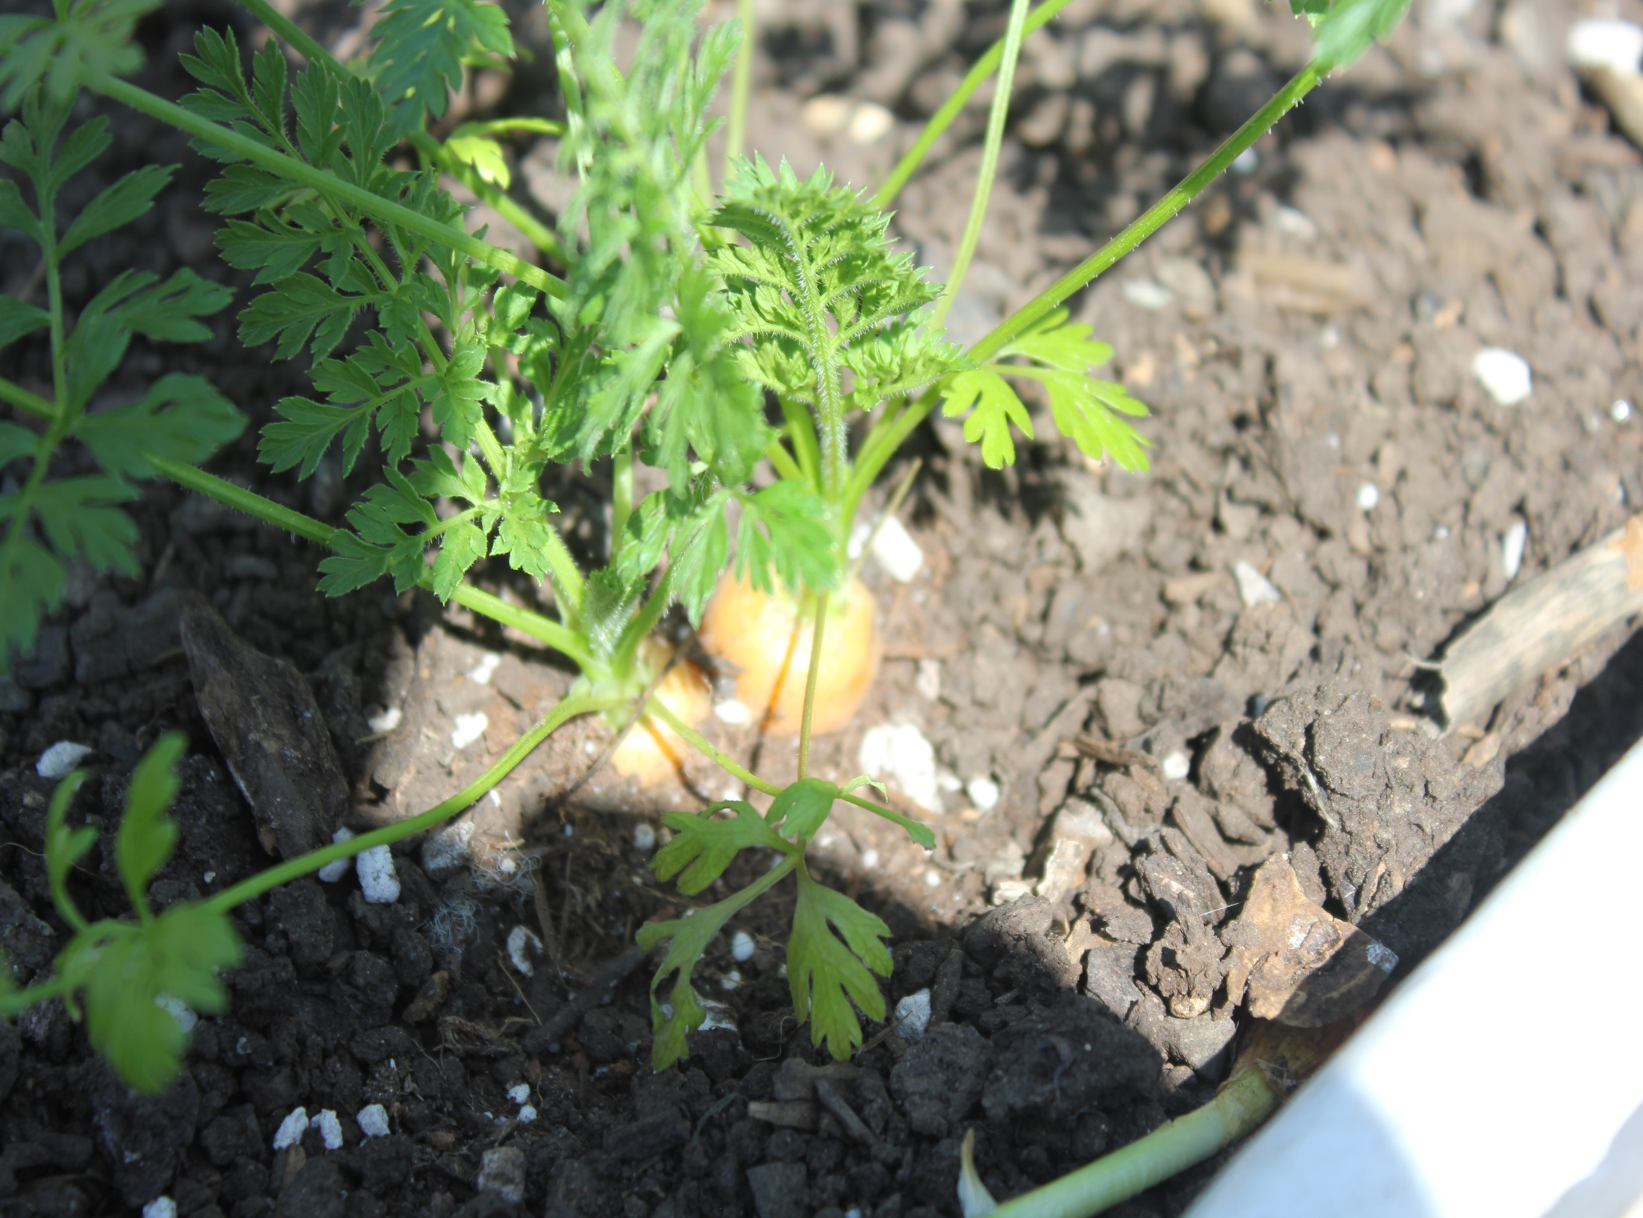
Carrot transplants produce
carrots by May.

Slide 27
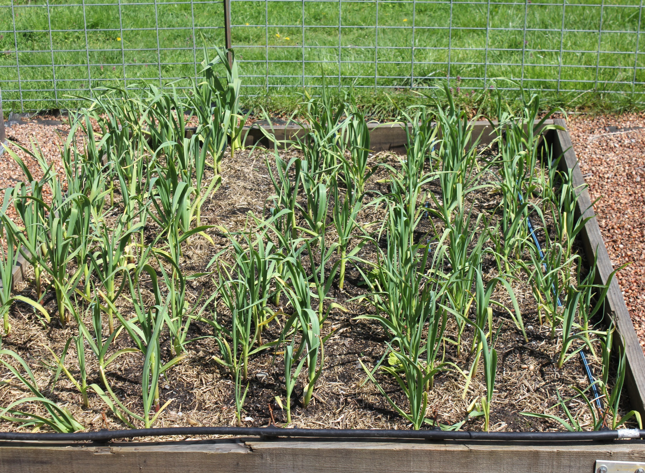
Garlic: Think vampires. Plant garlic on Halloween, harvest in June.
Note: double row straddling the drip tape.

Slide 28
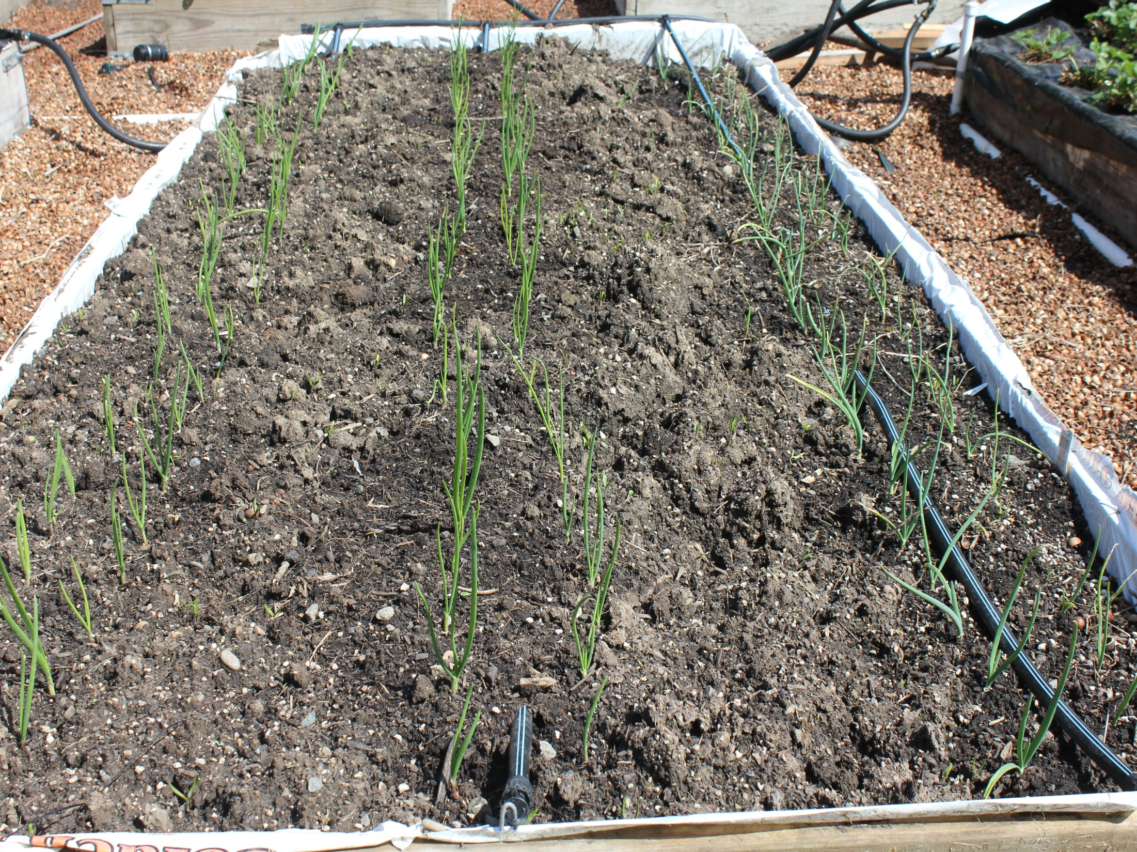
Onion “bulbs”
planted March
15. Harvest in
July/August
On right,
Walla Walla
Sweet onions.
Plant in Fall--Harvest
in June. Huge!

Slide 29
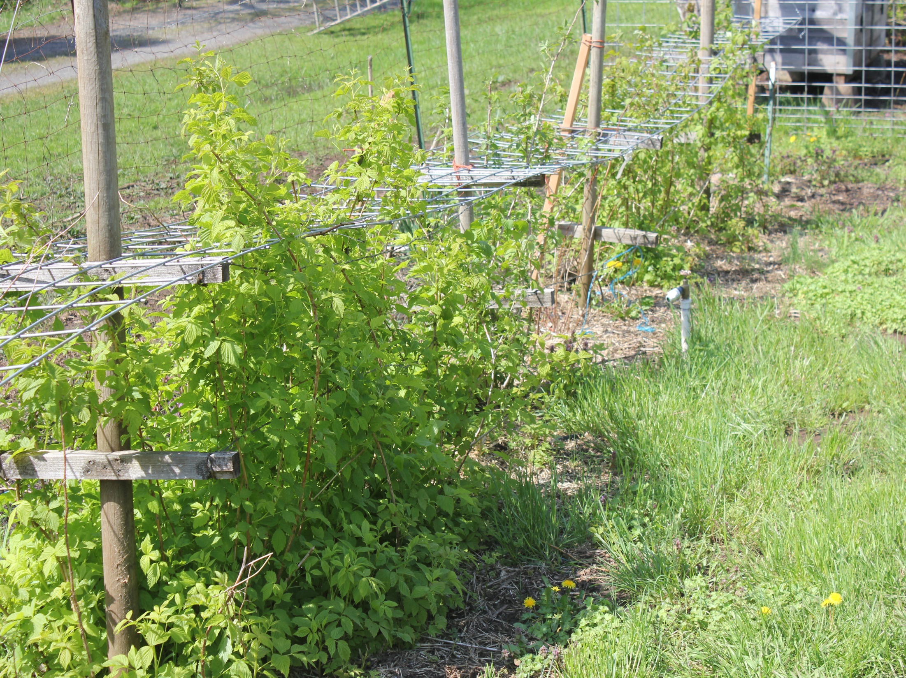
2016 raspberry plantings
Use heavy steel fence
material to hold up.

Slide 30
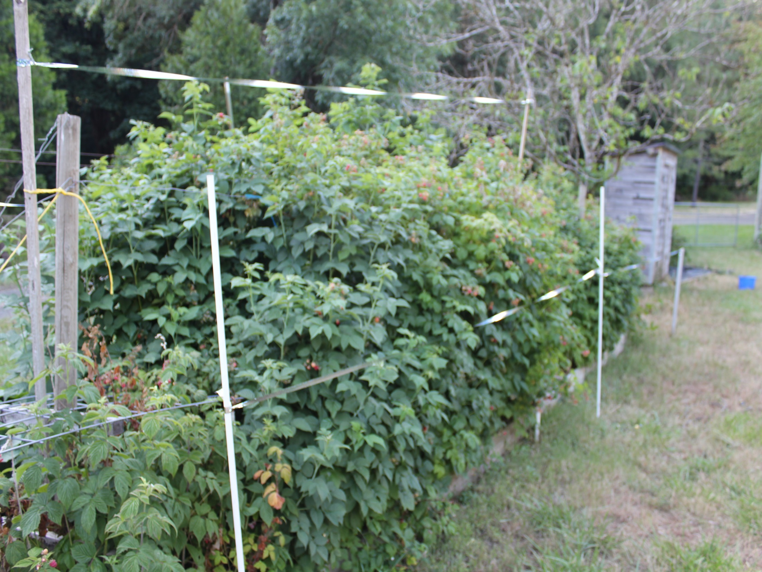
2019 Raspberries

Slide 31
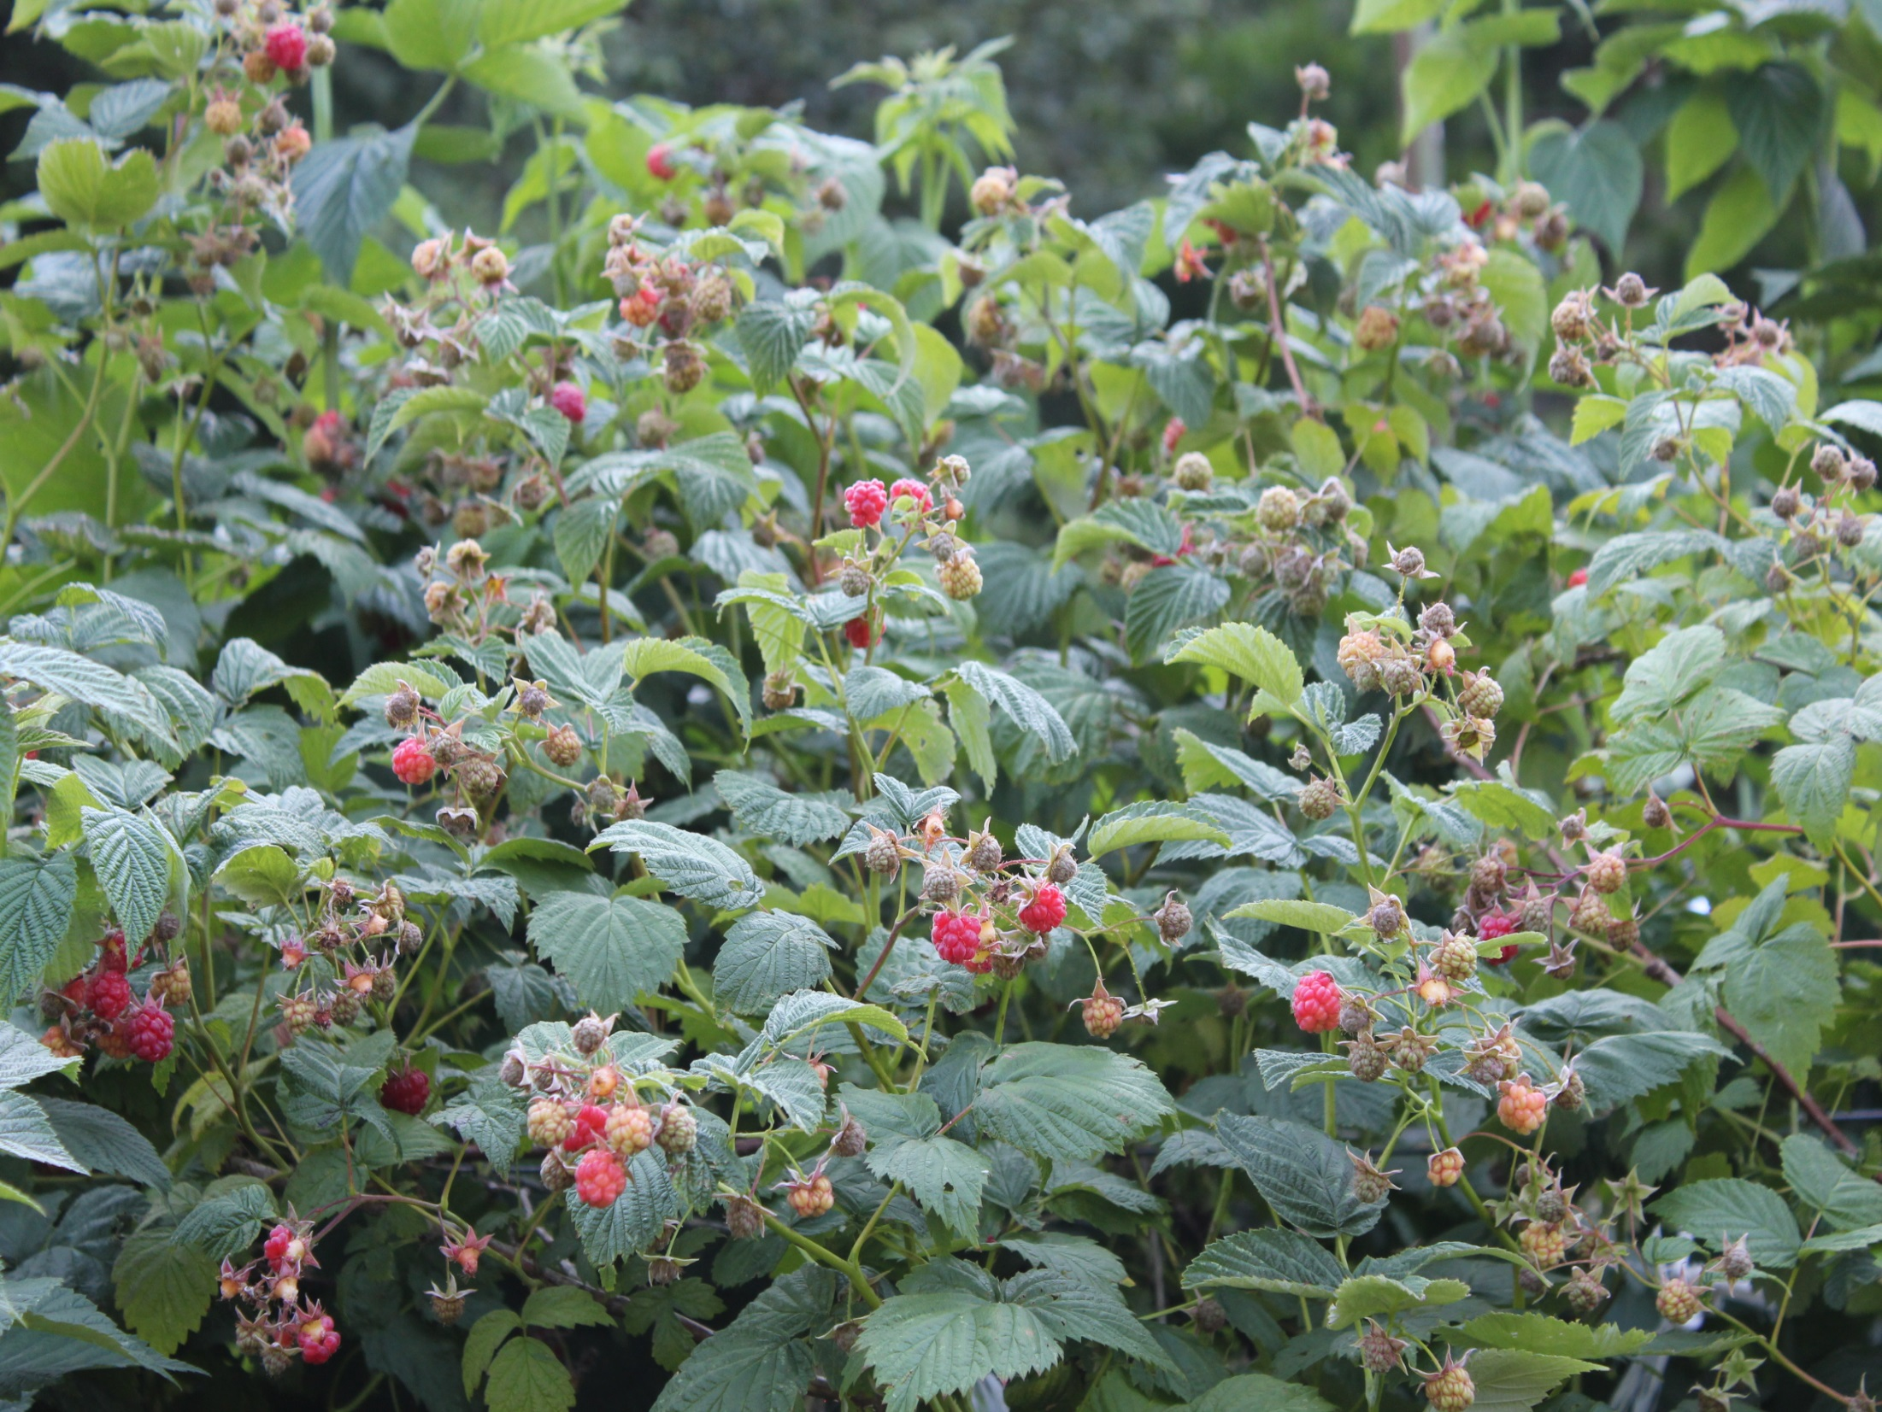

Slide 32
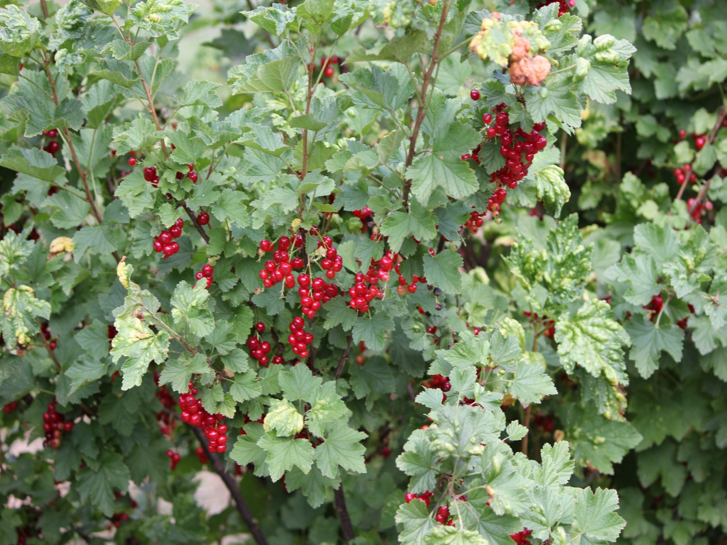
Currents for jelly

Slide 33
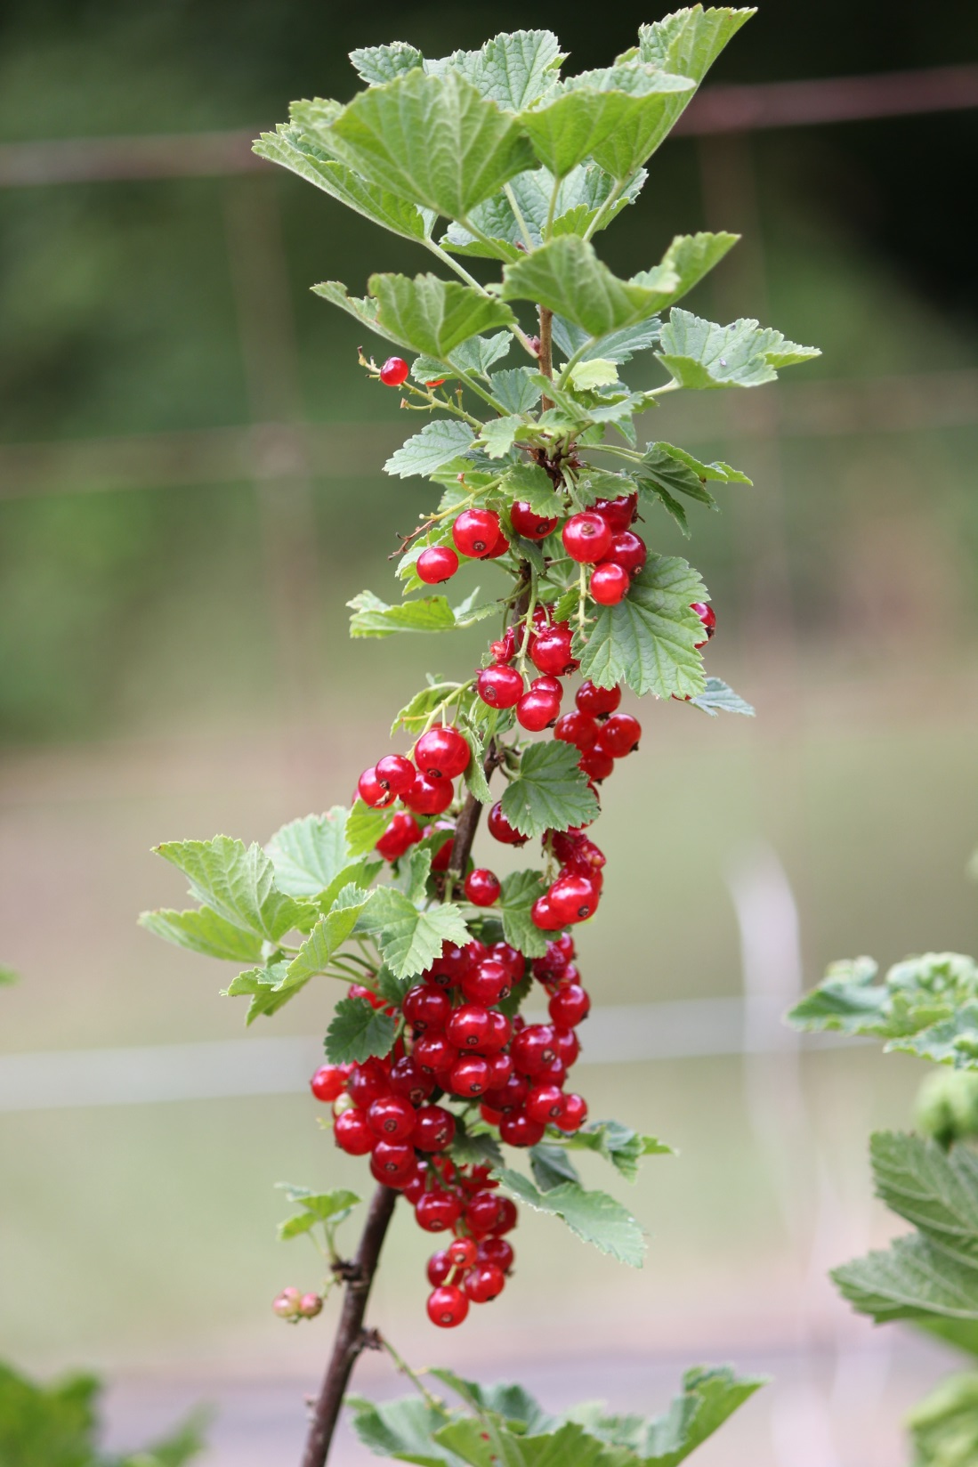

Slide 34
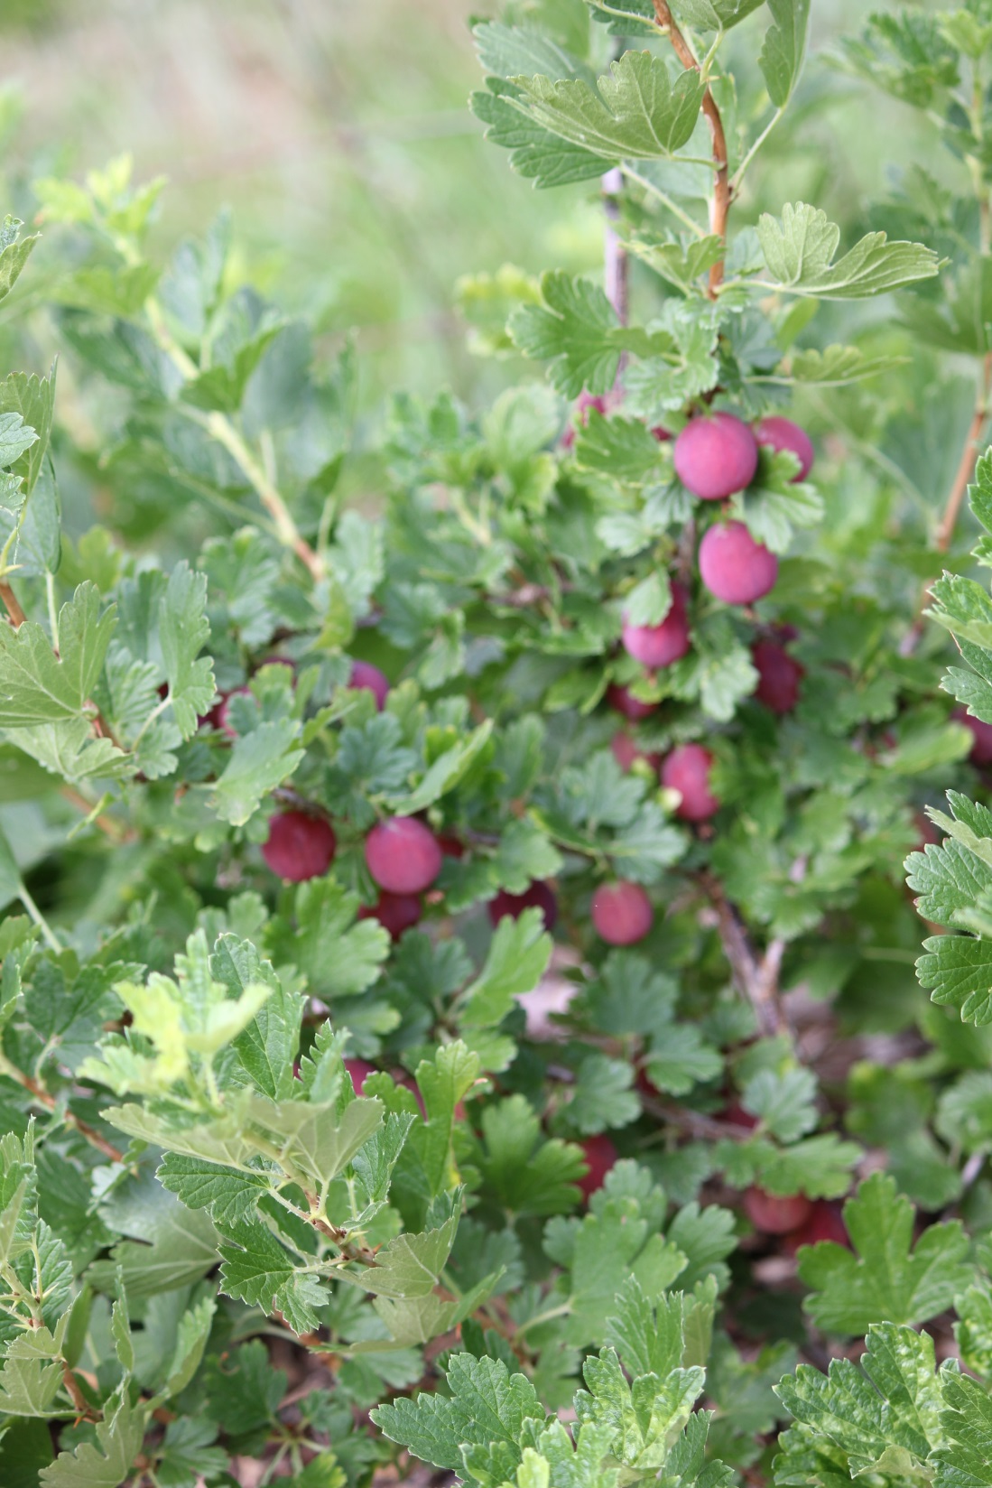
Gooseberries

Slide 35
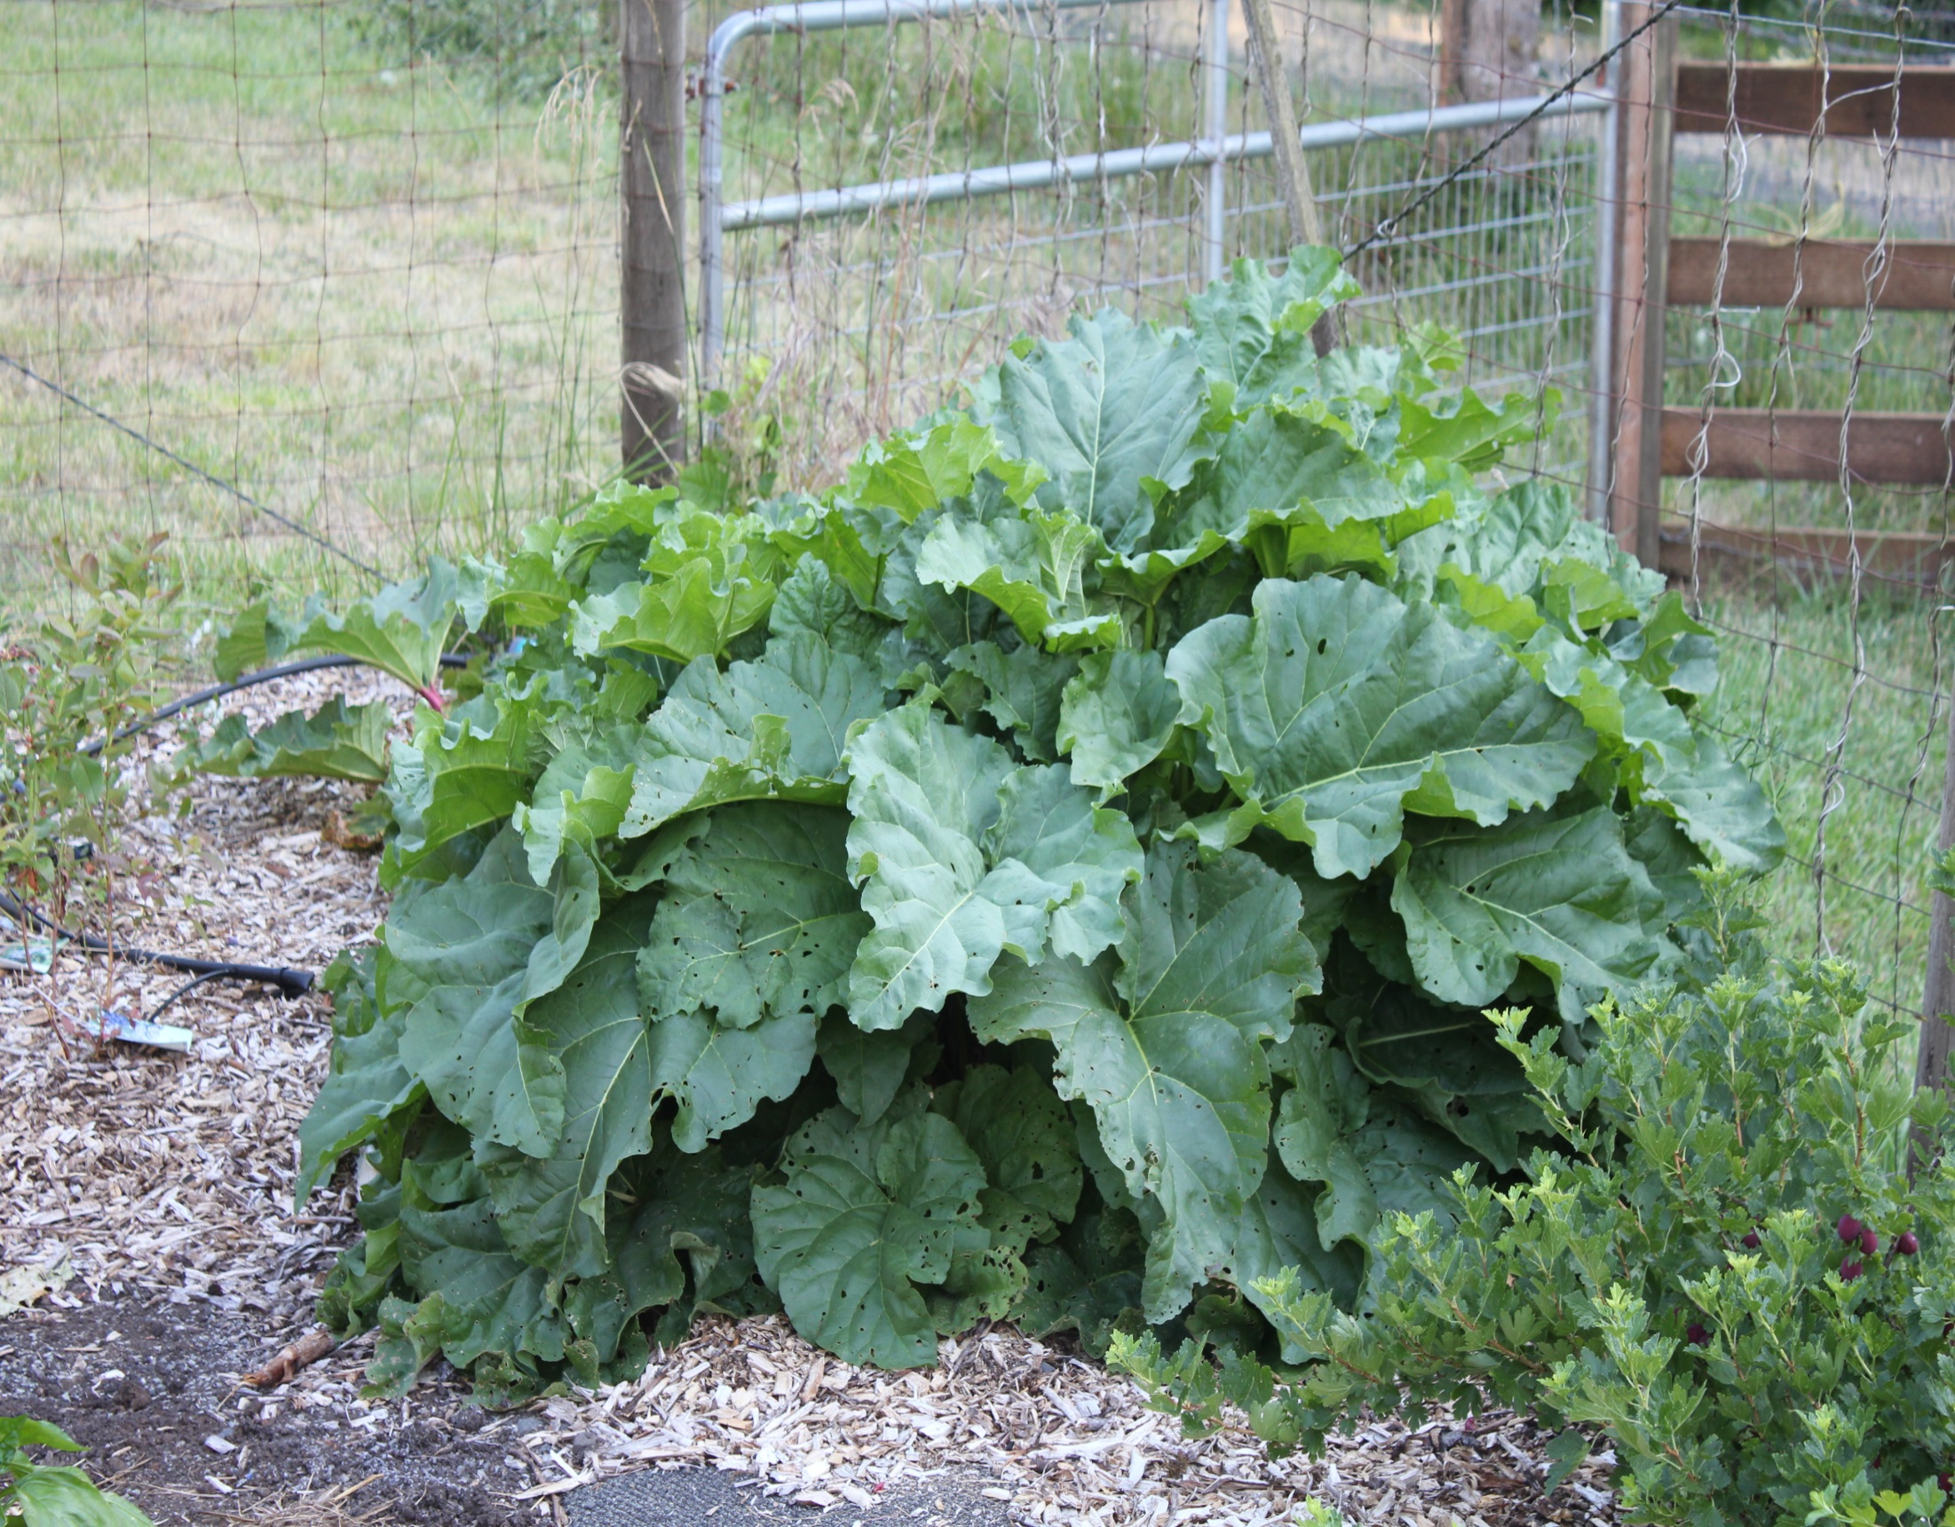
Rhubarb

Slide 36
Later in the summer
Photos taken in September/October

Slide 37
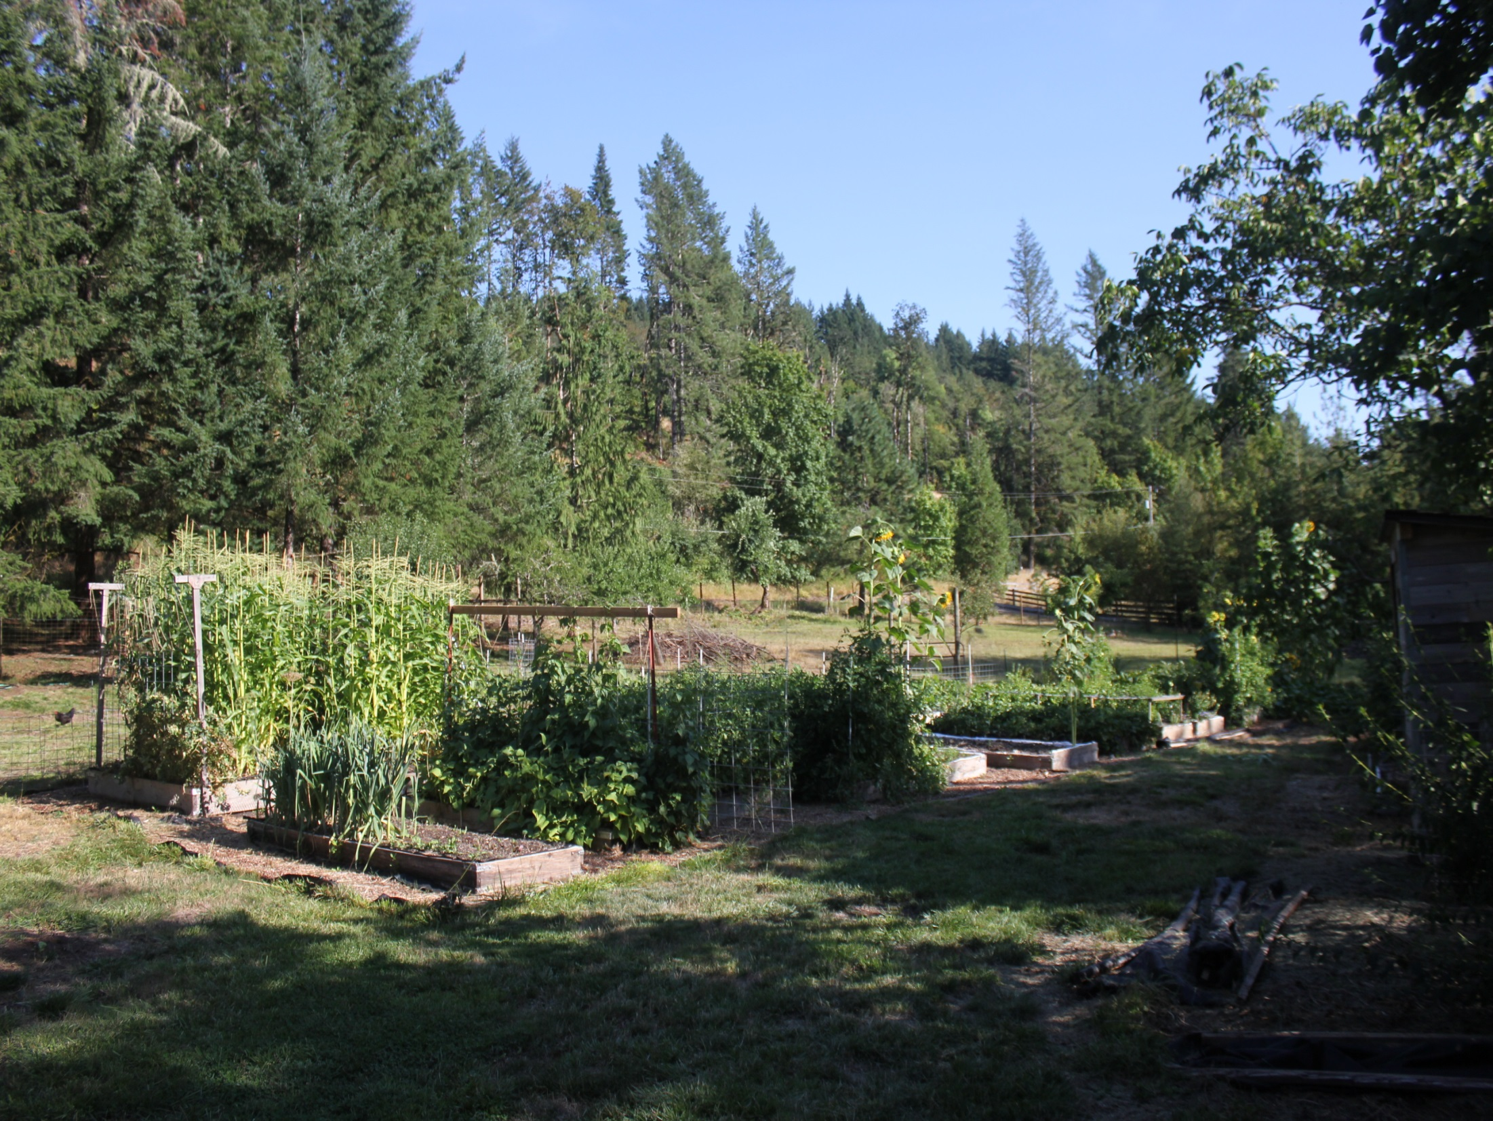

Slide 38
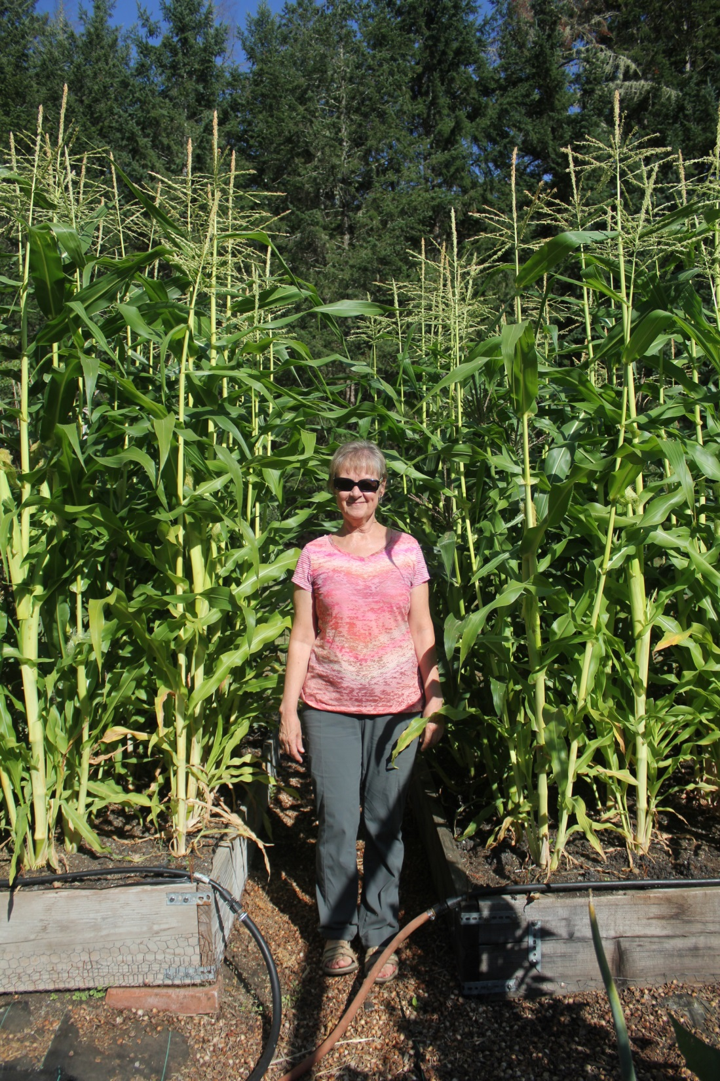

Slide 39
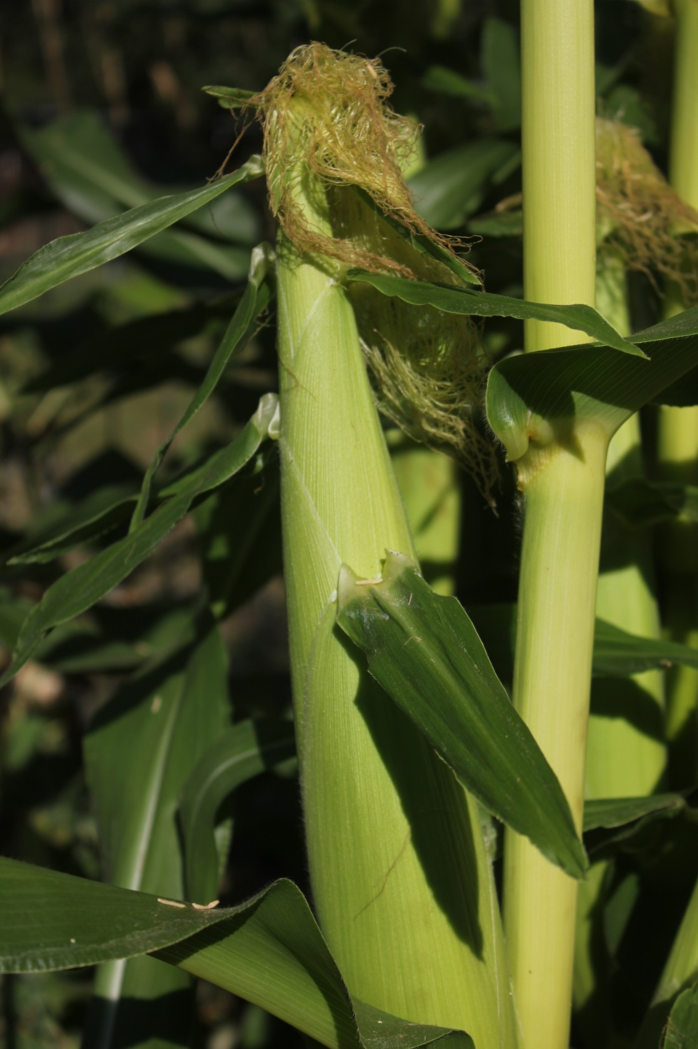

Slide 40
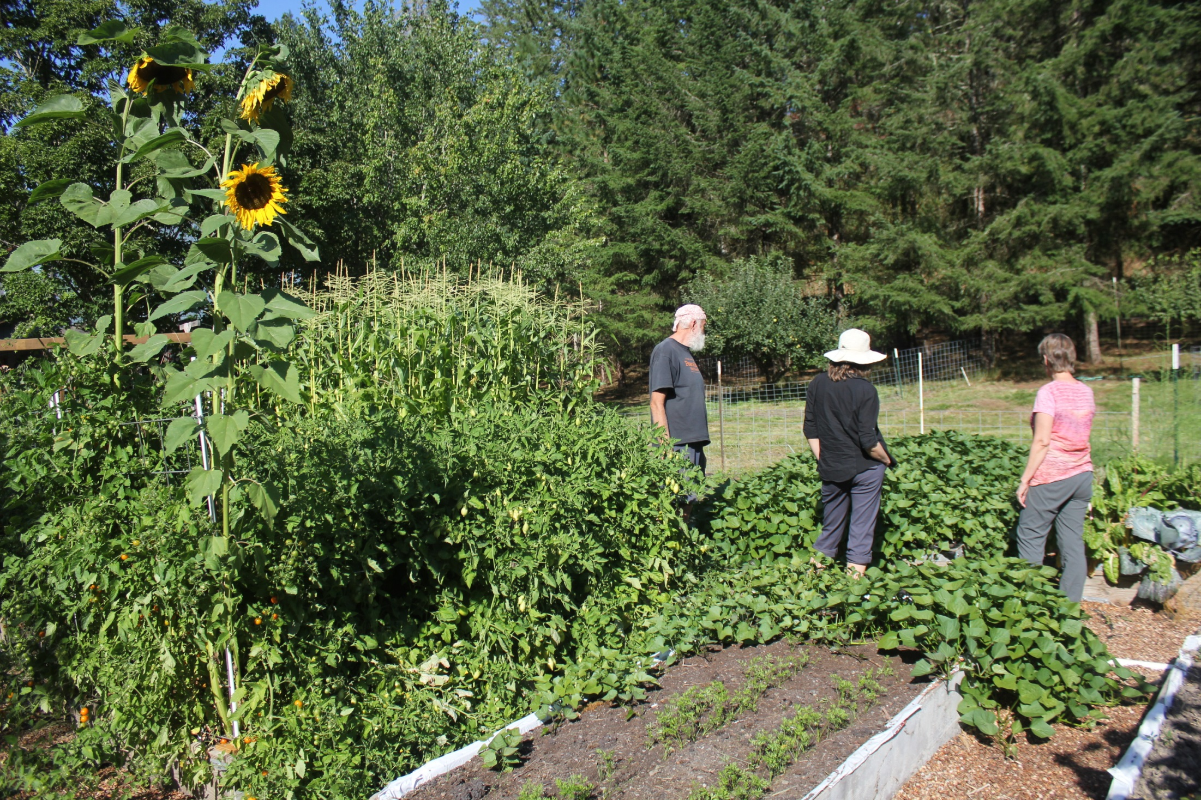

Slide 41
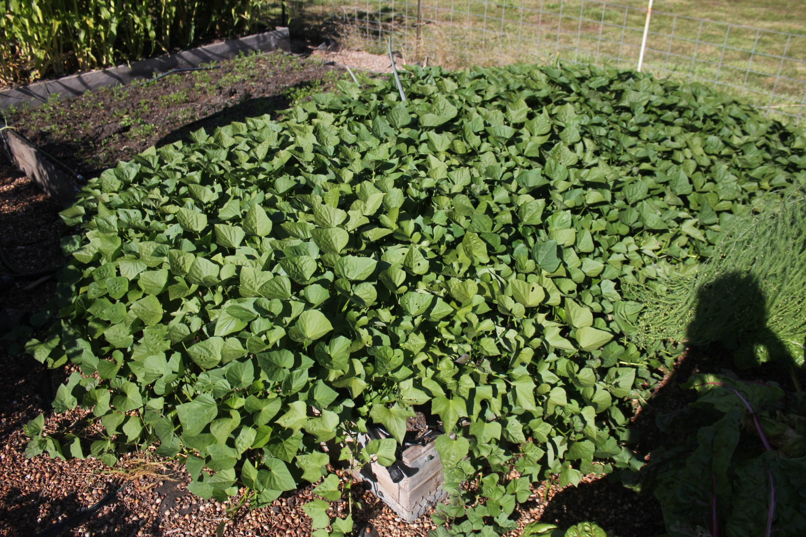

Slide 42
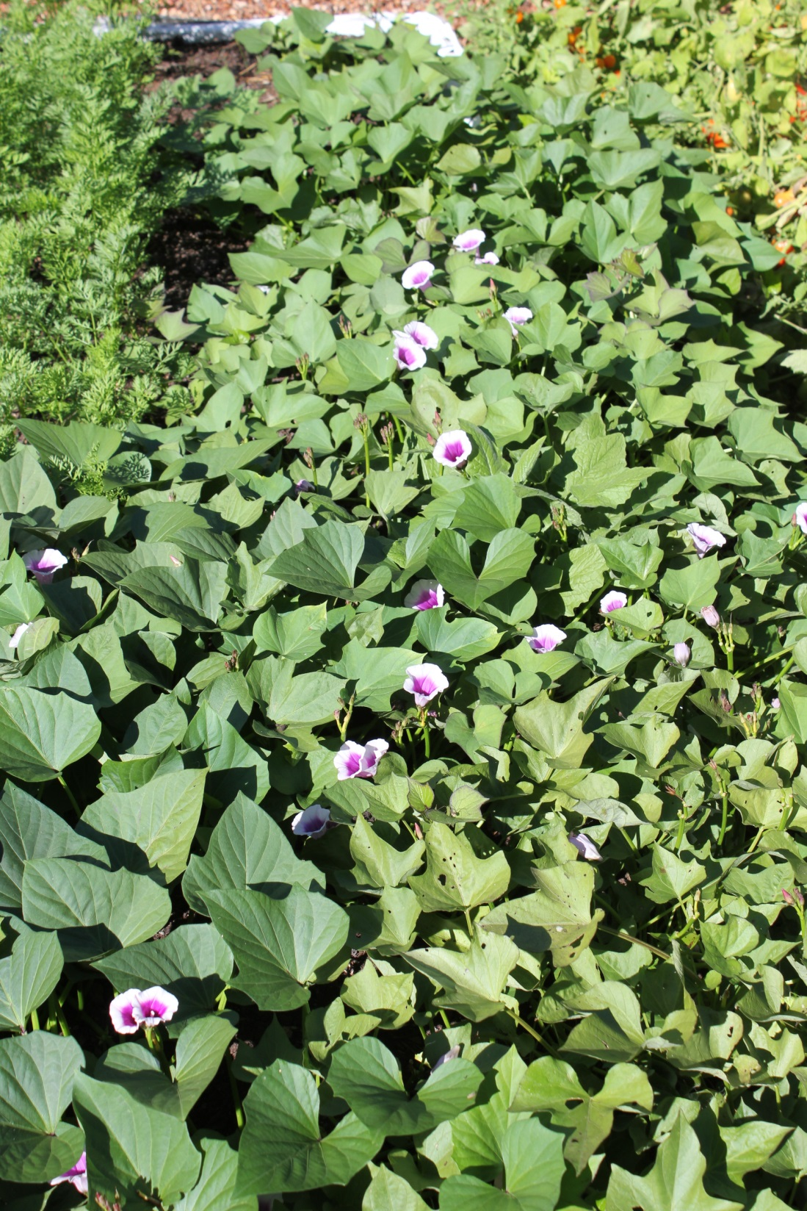
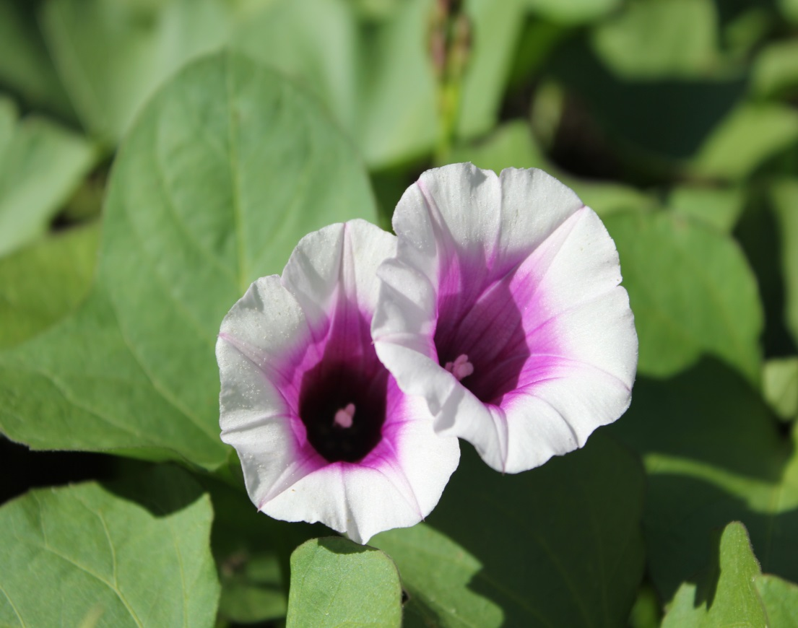
Sweet Potato Flowers

Slide 43
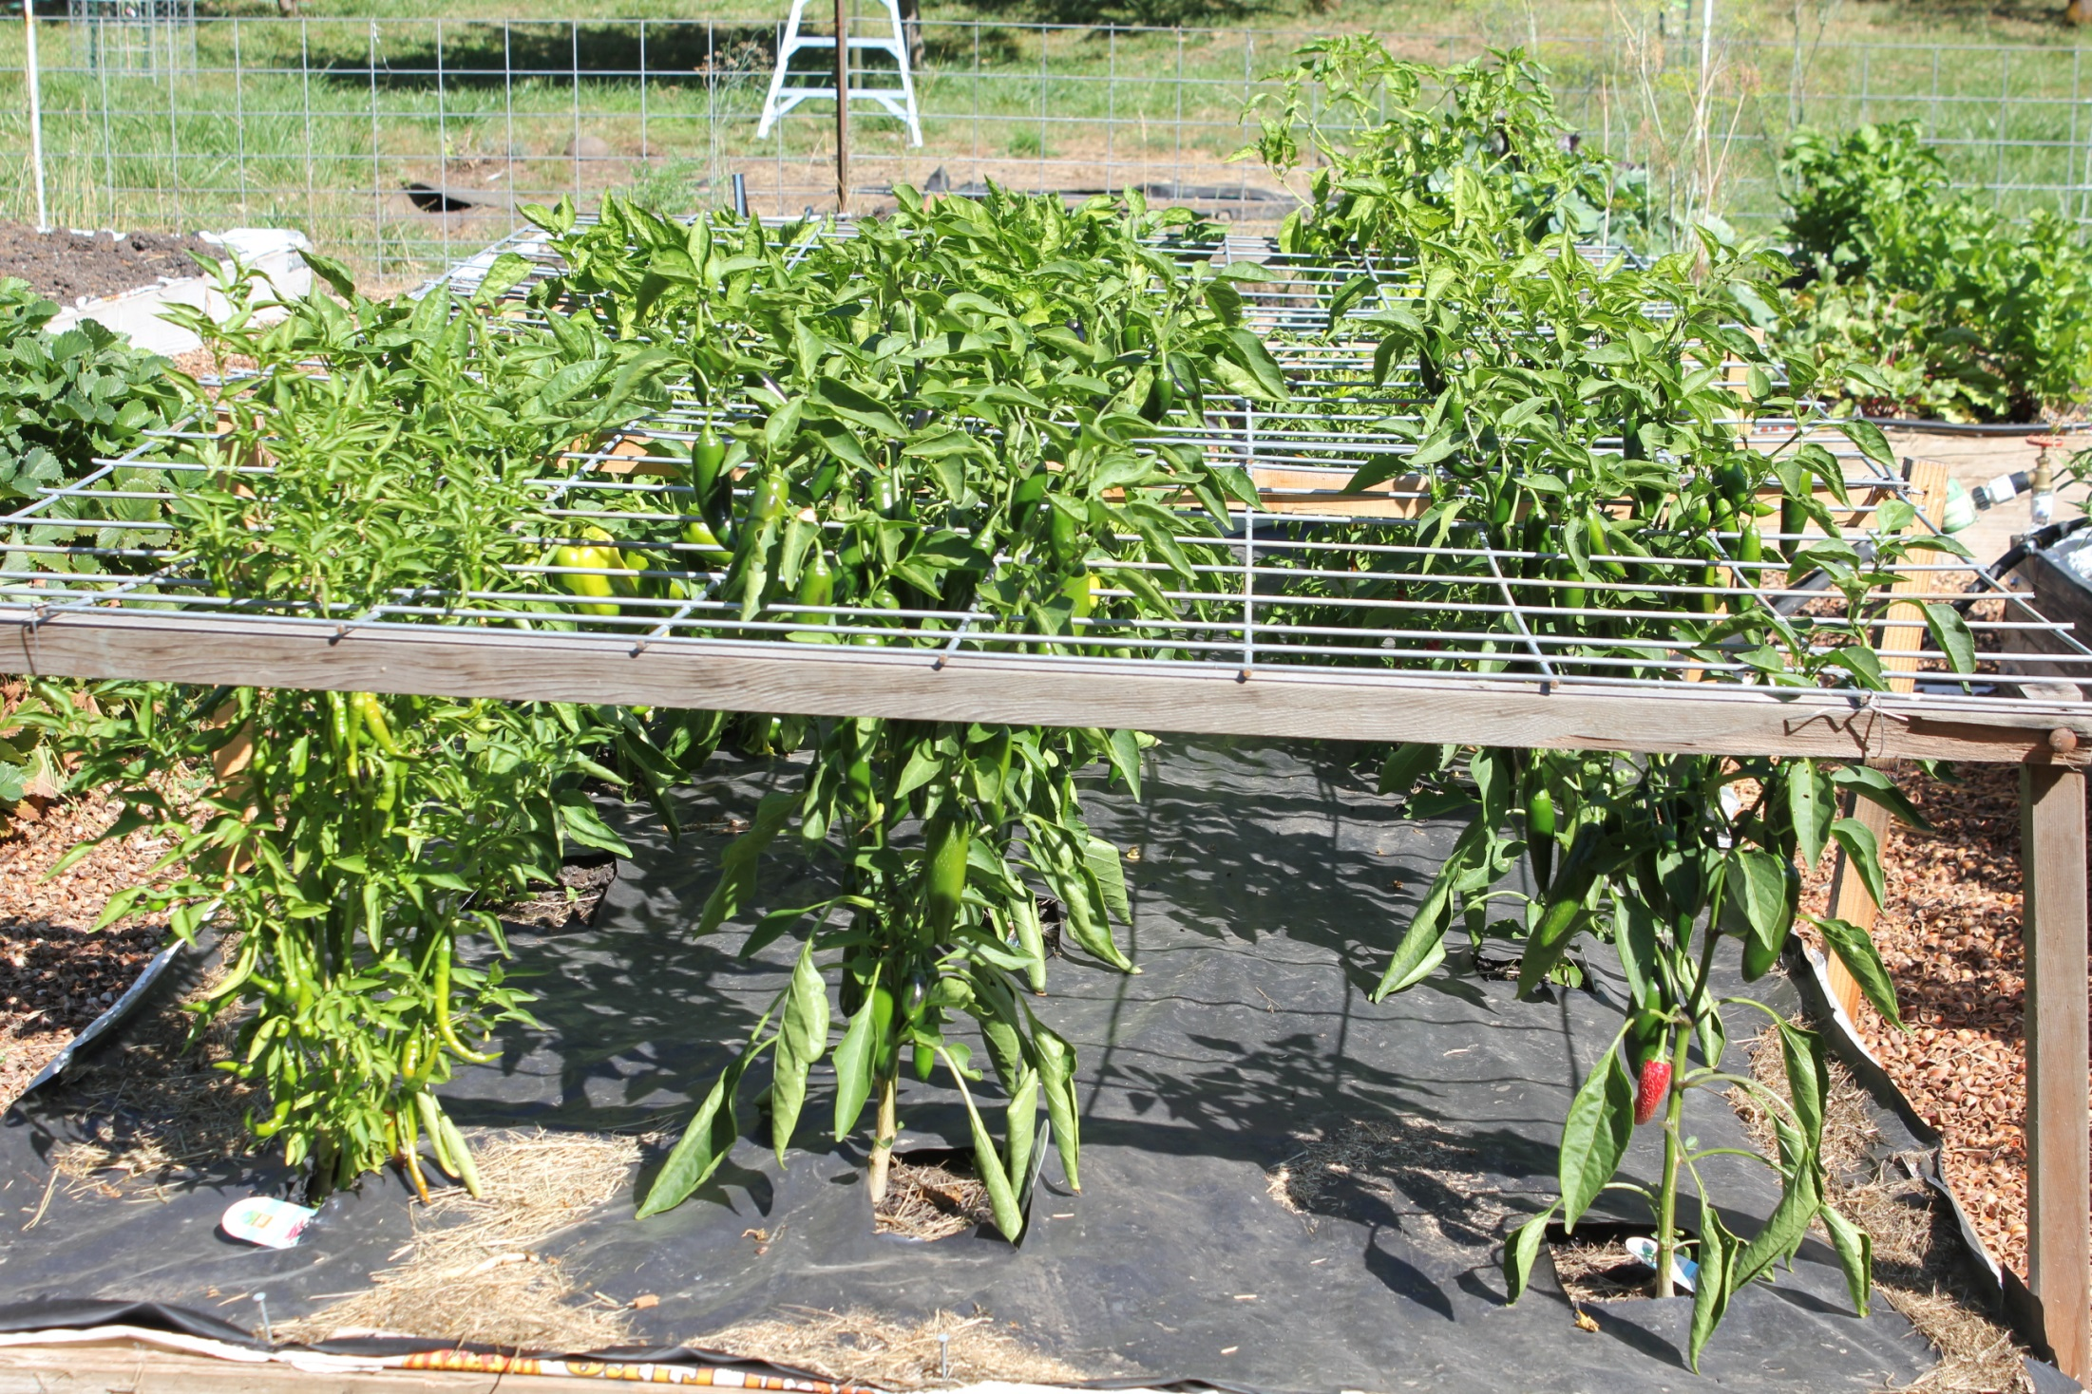

Slide 44
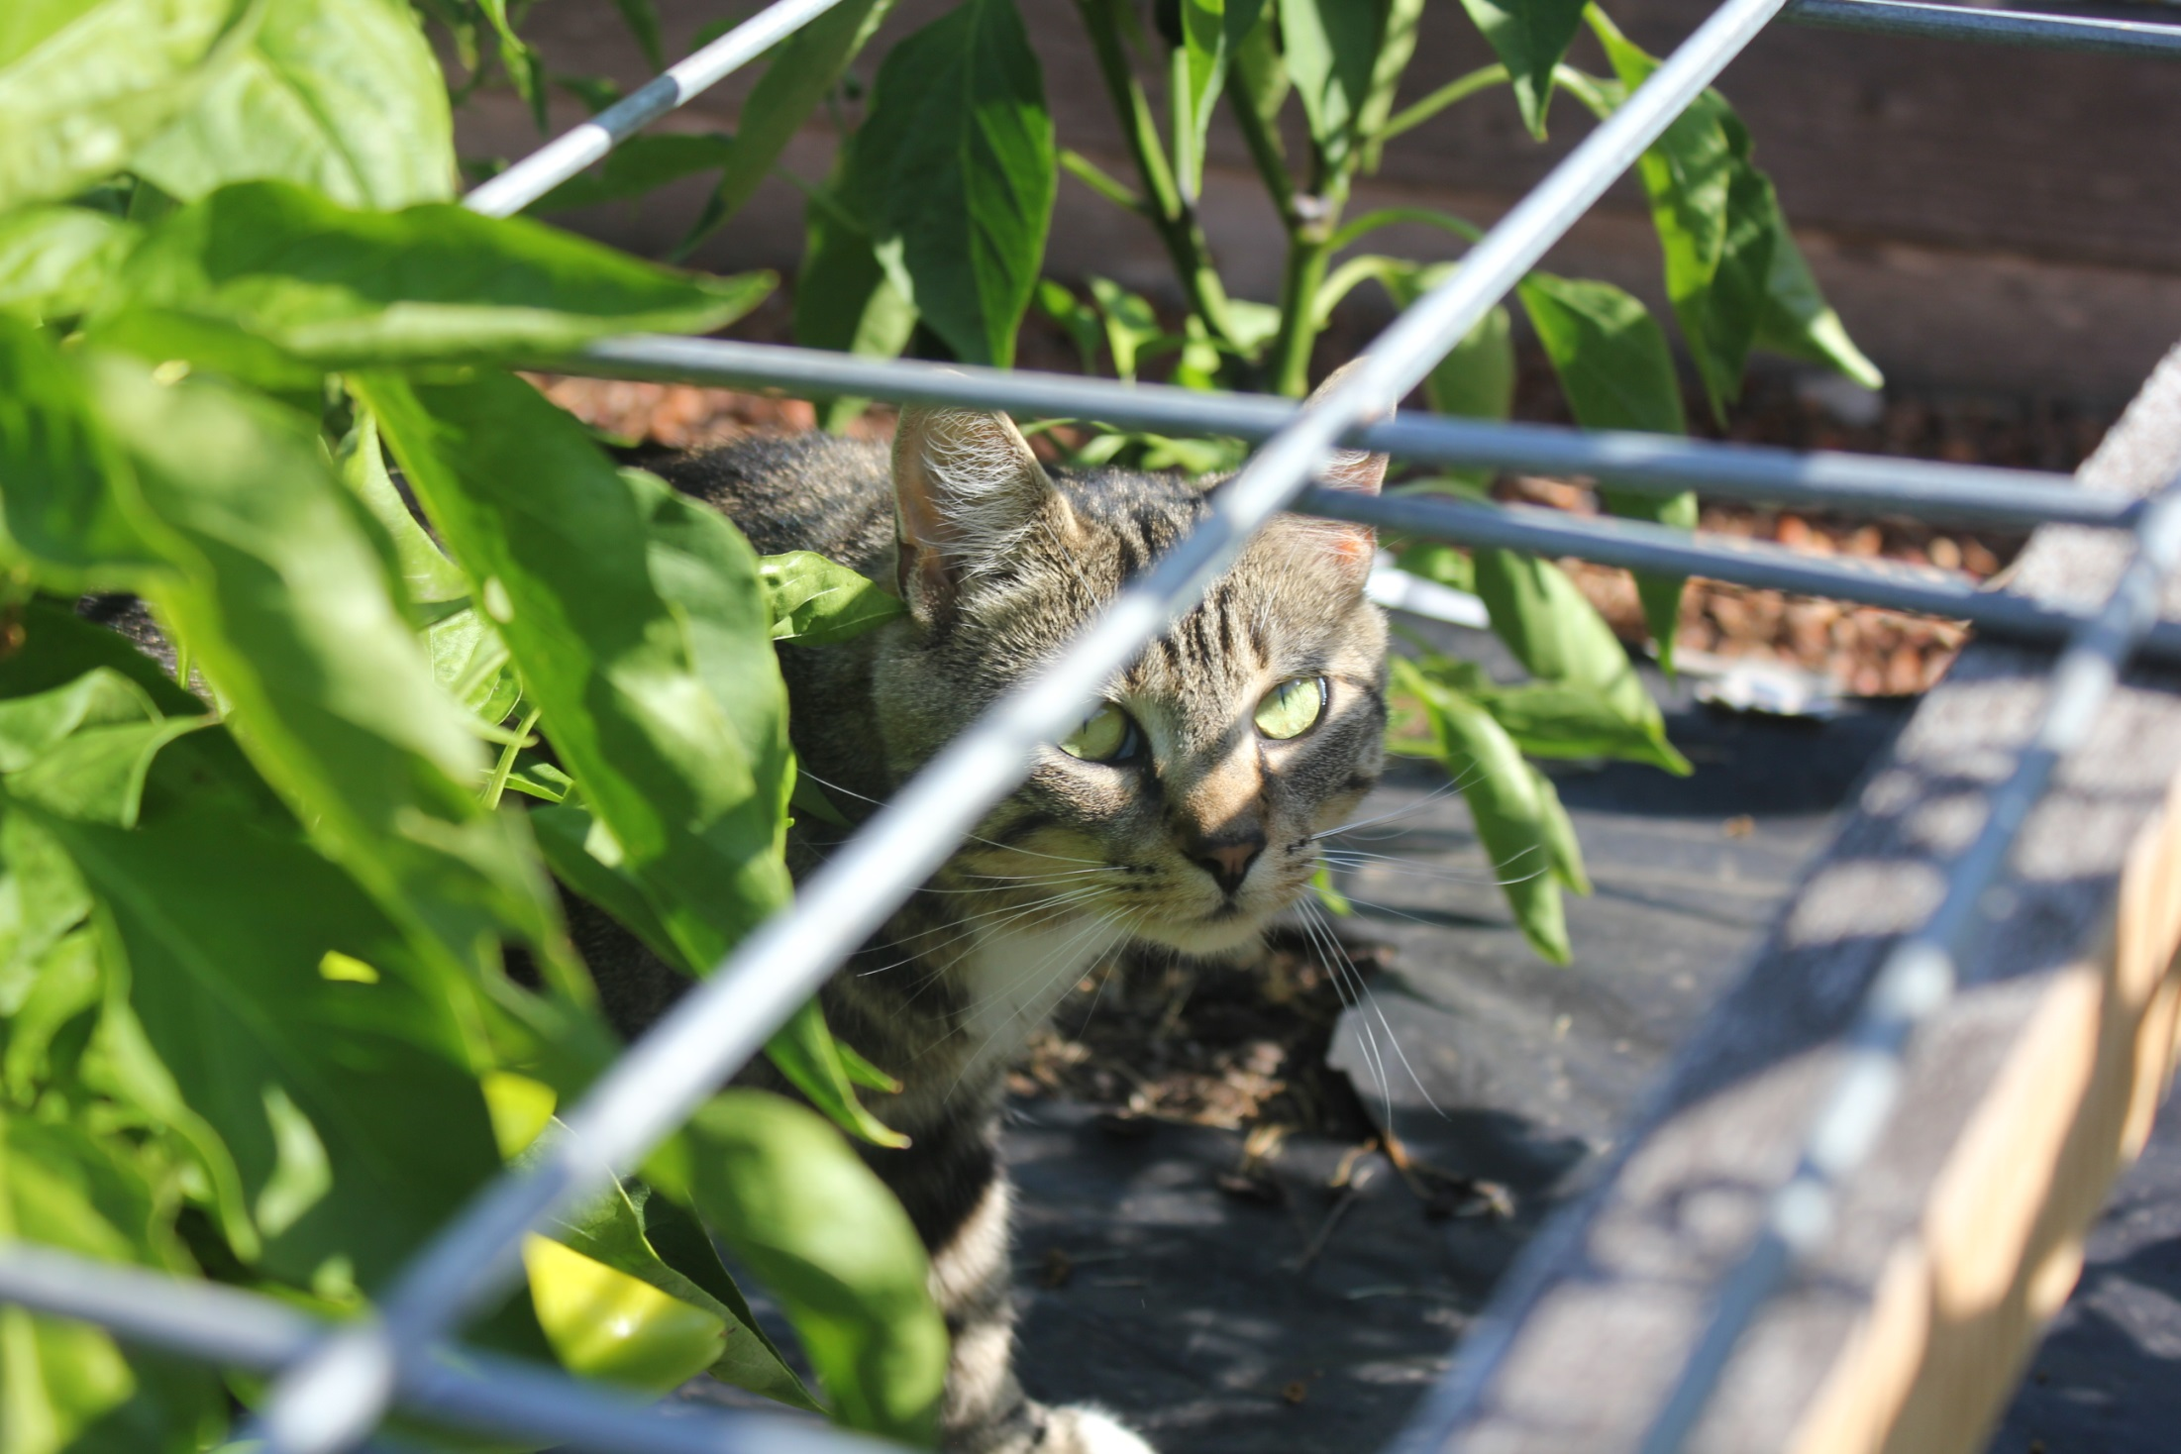

Slide 45
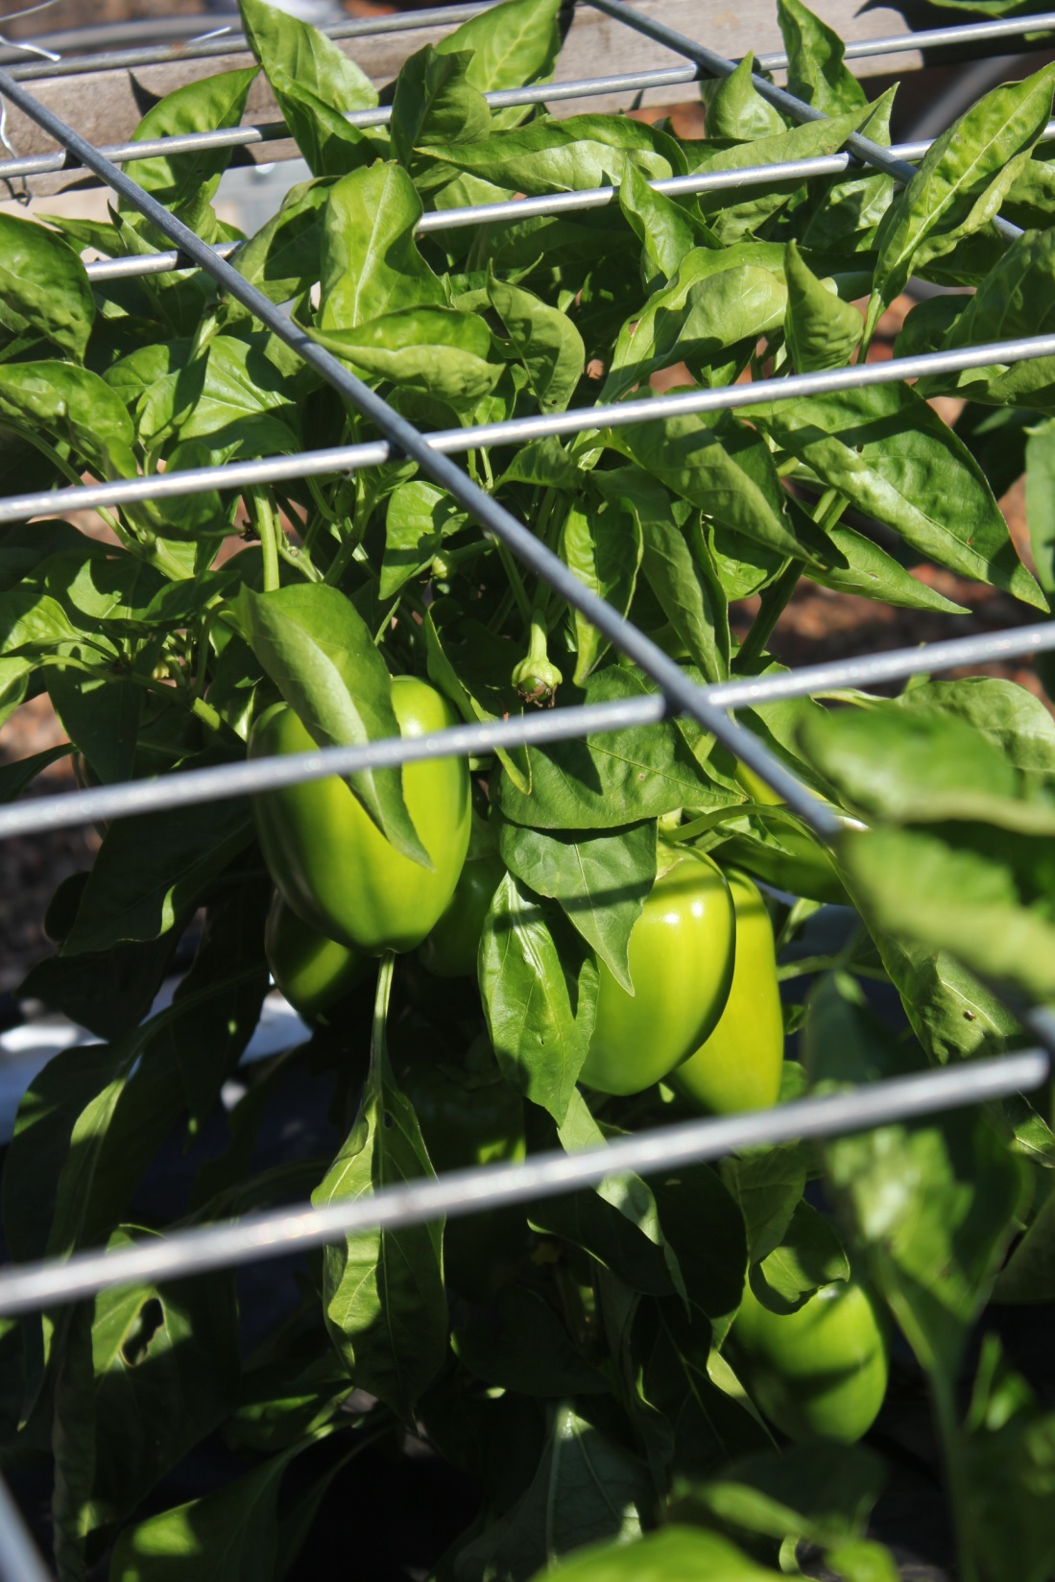
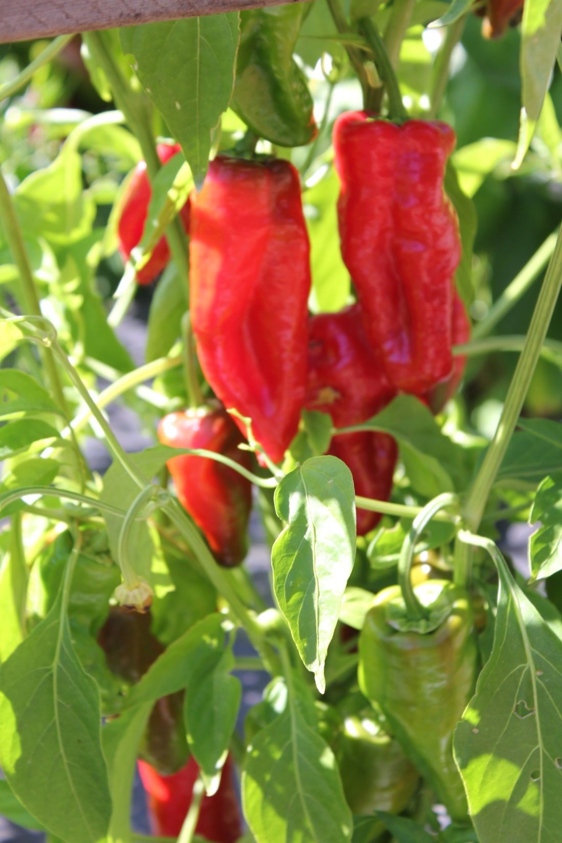

Slide 46
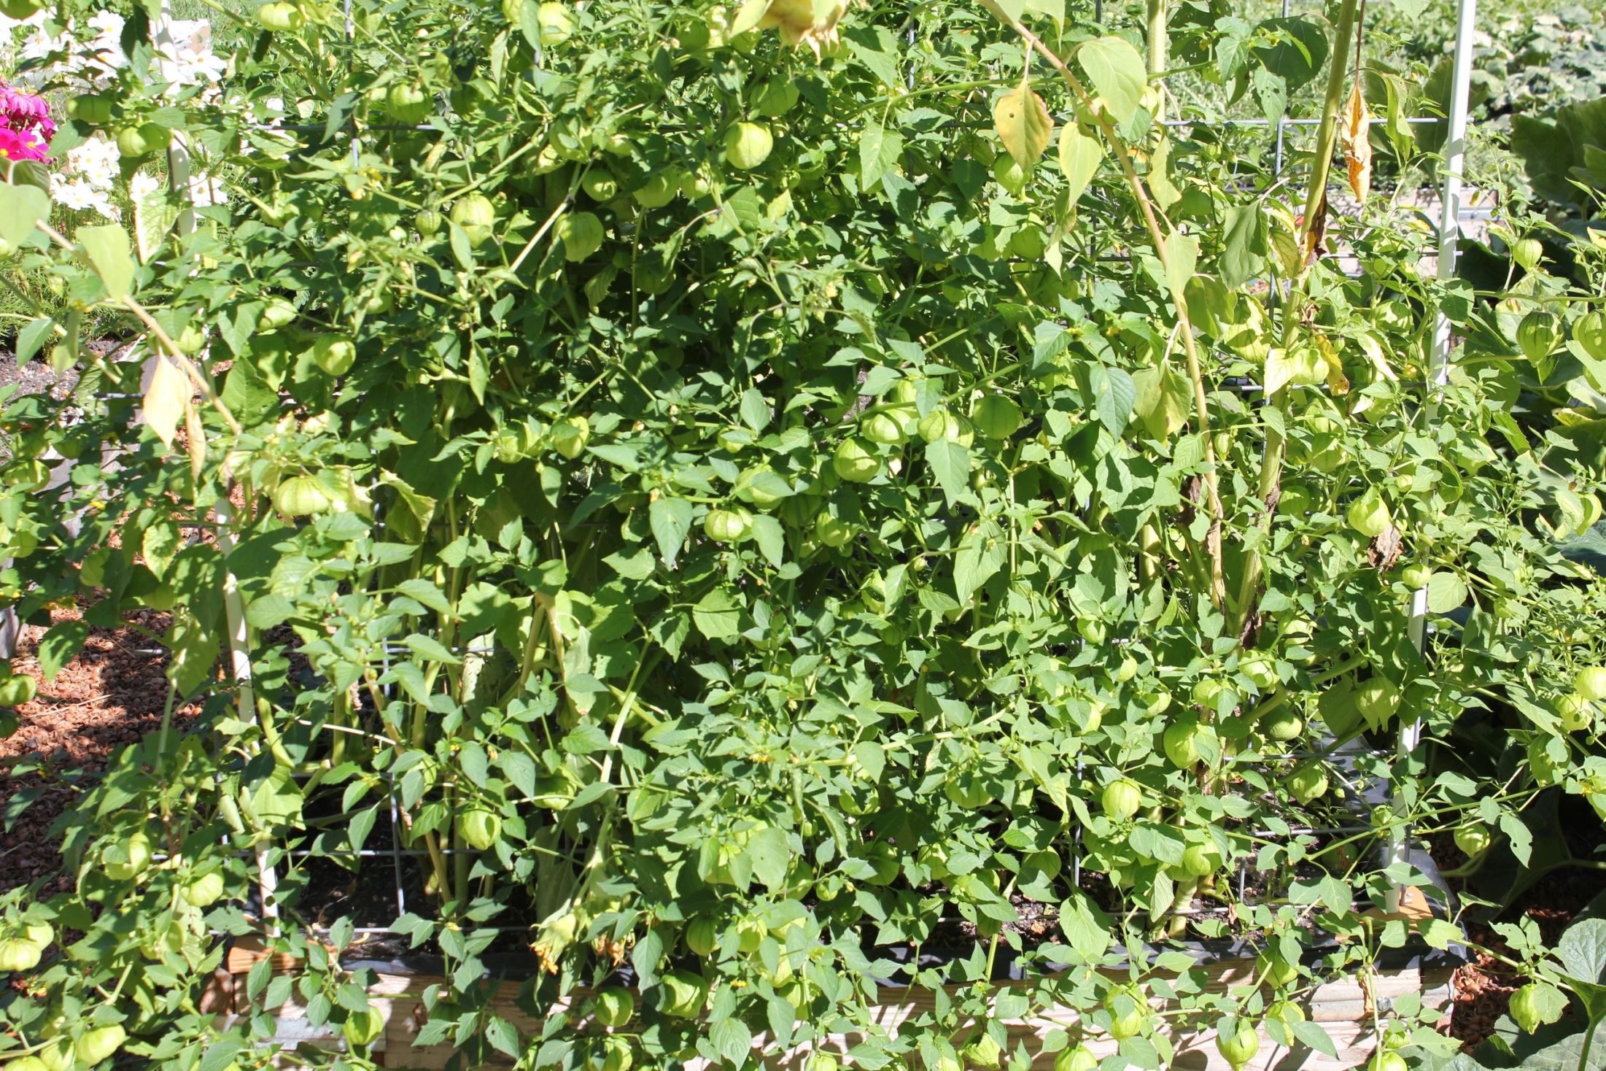
Tomatillos—coolest nature design

Slide 47
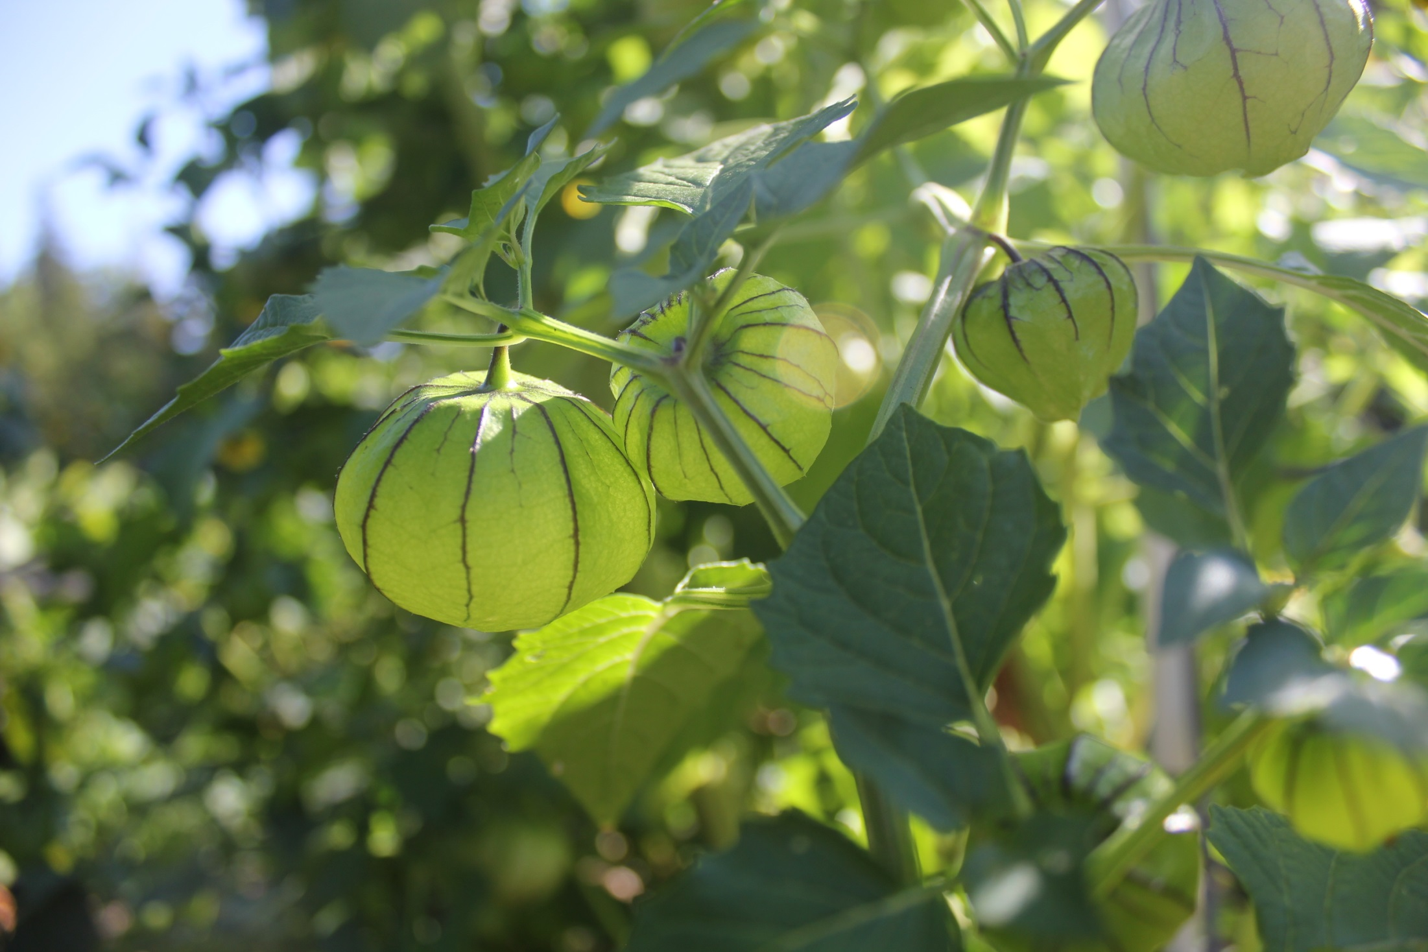

Slide 48
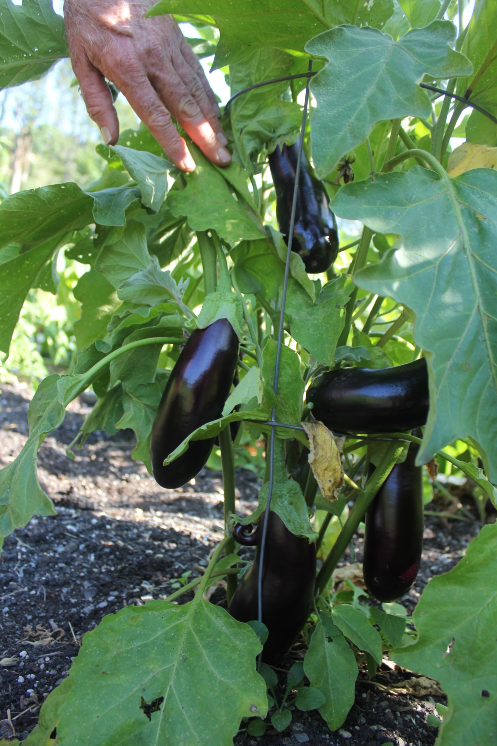

Slide 49
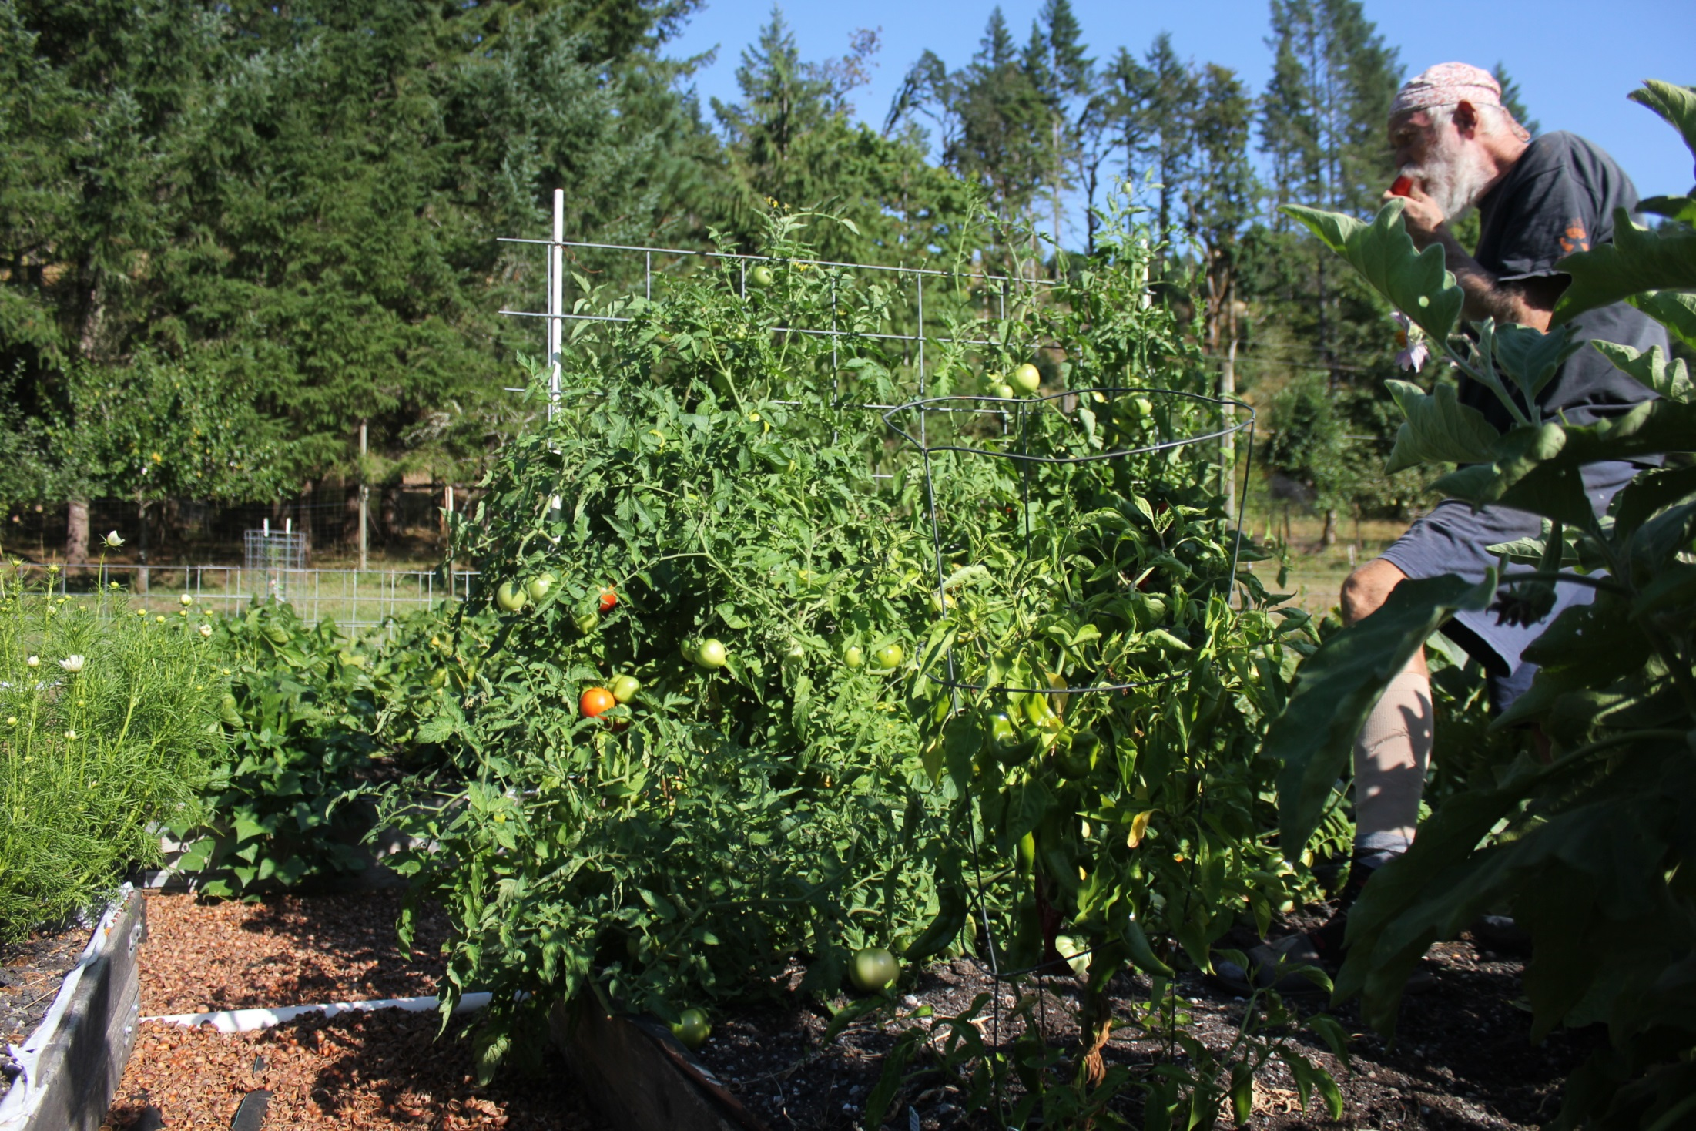

Slide 50
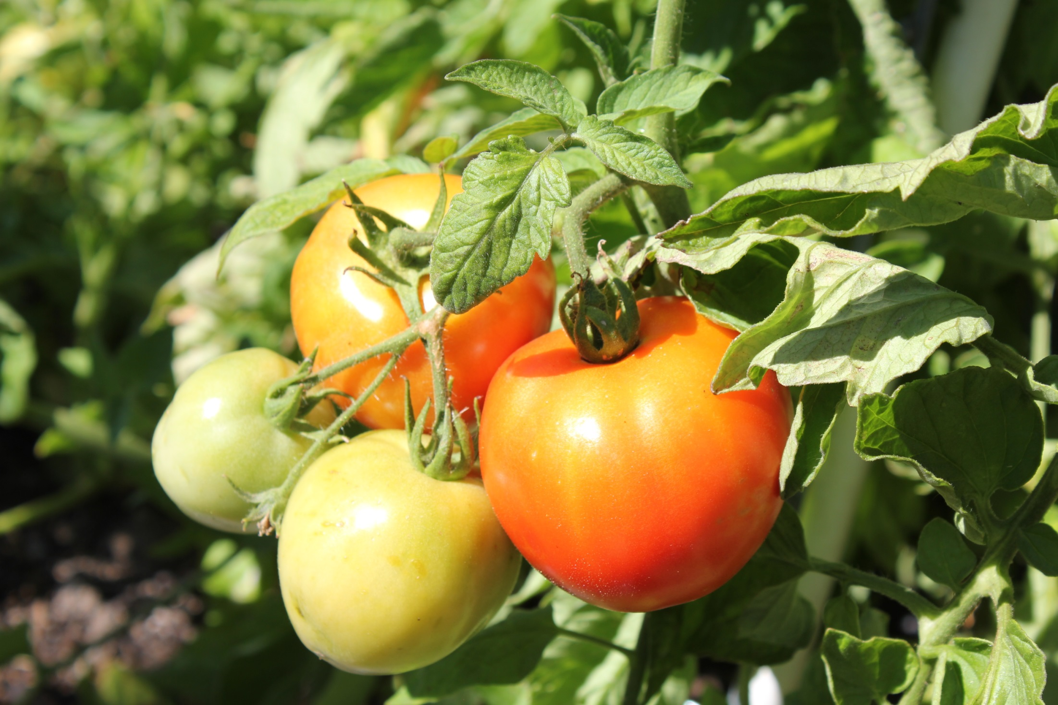

Slide 51
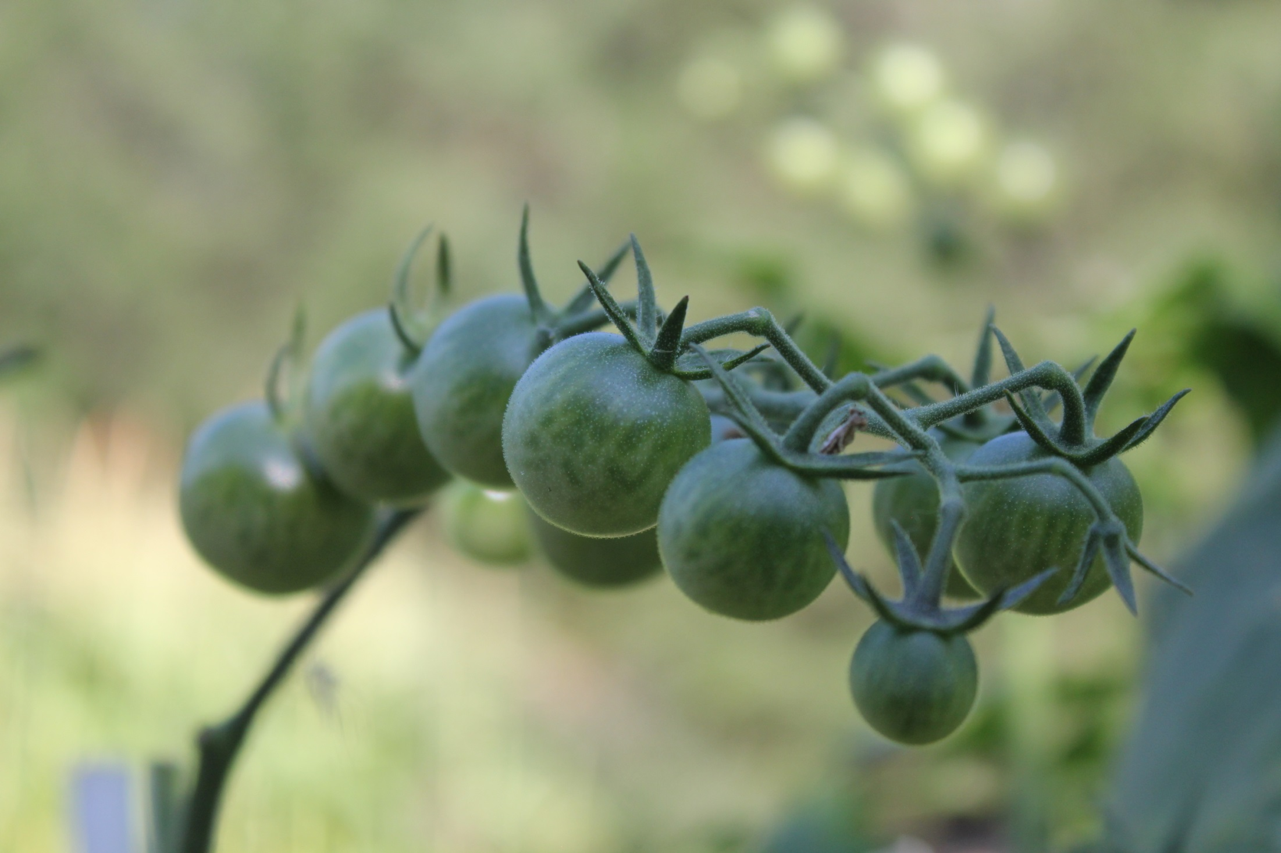

Slide 52
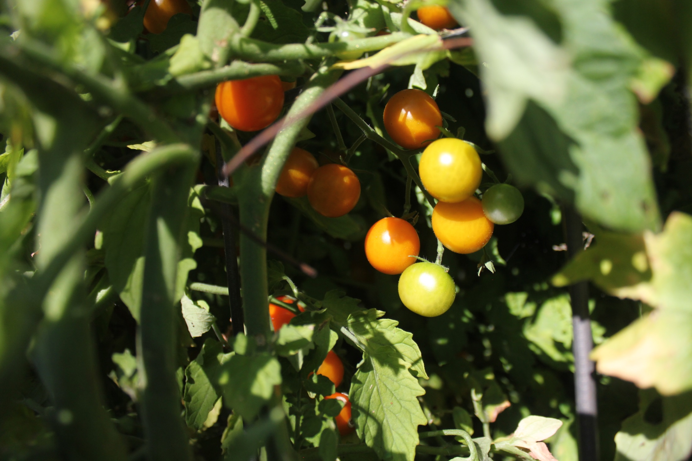
Sungold, as sweet as
Eating candy

Slide 53
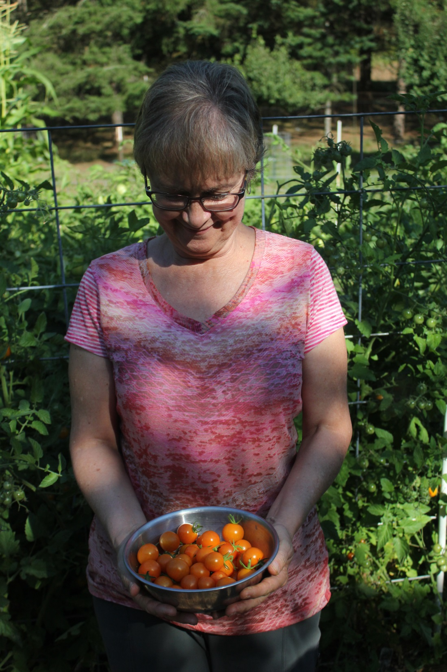

Slide 54
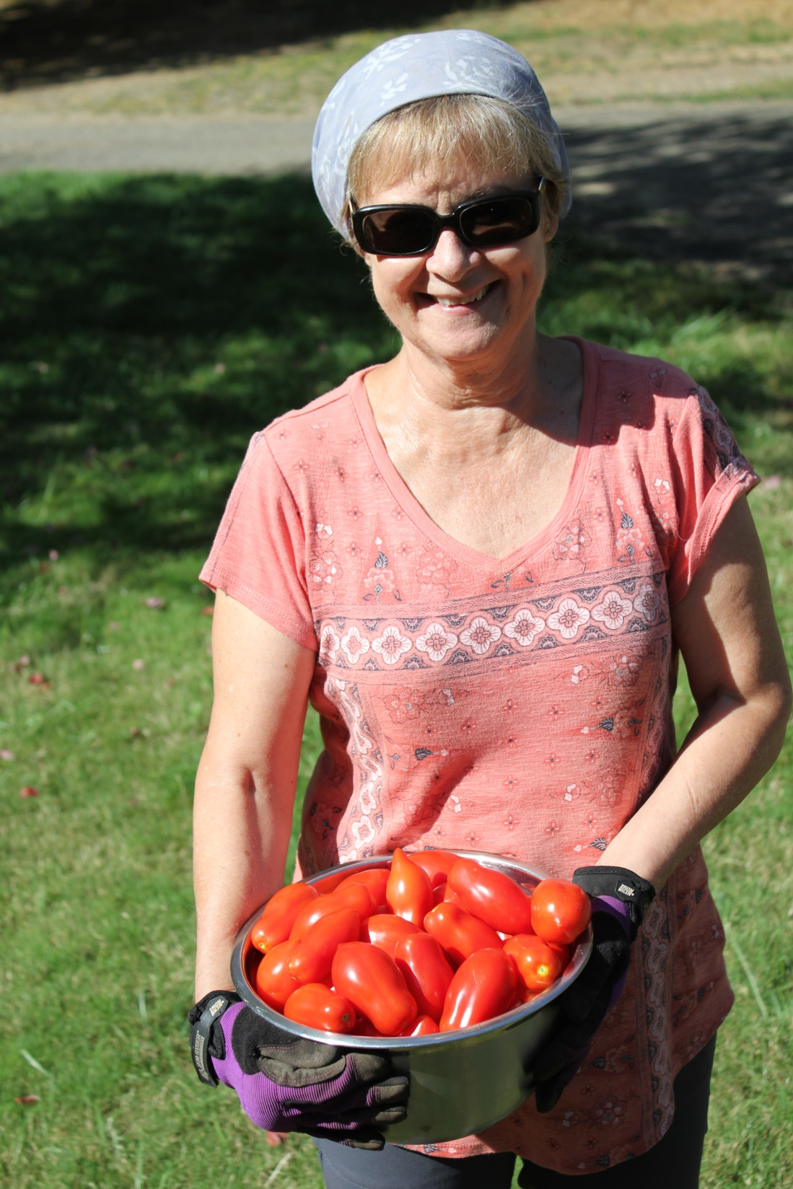
Roma Tomatoes
Best for sauce

Slide 55
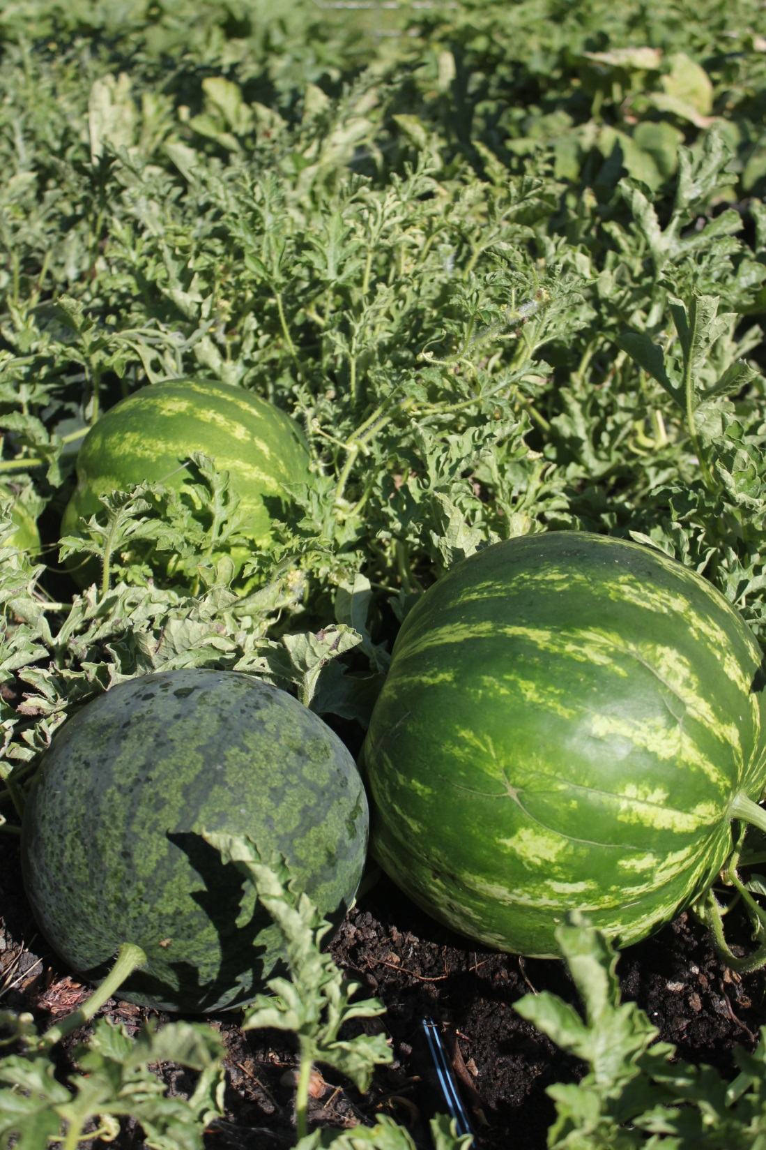

Slide 56
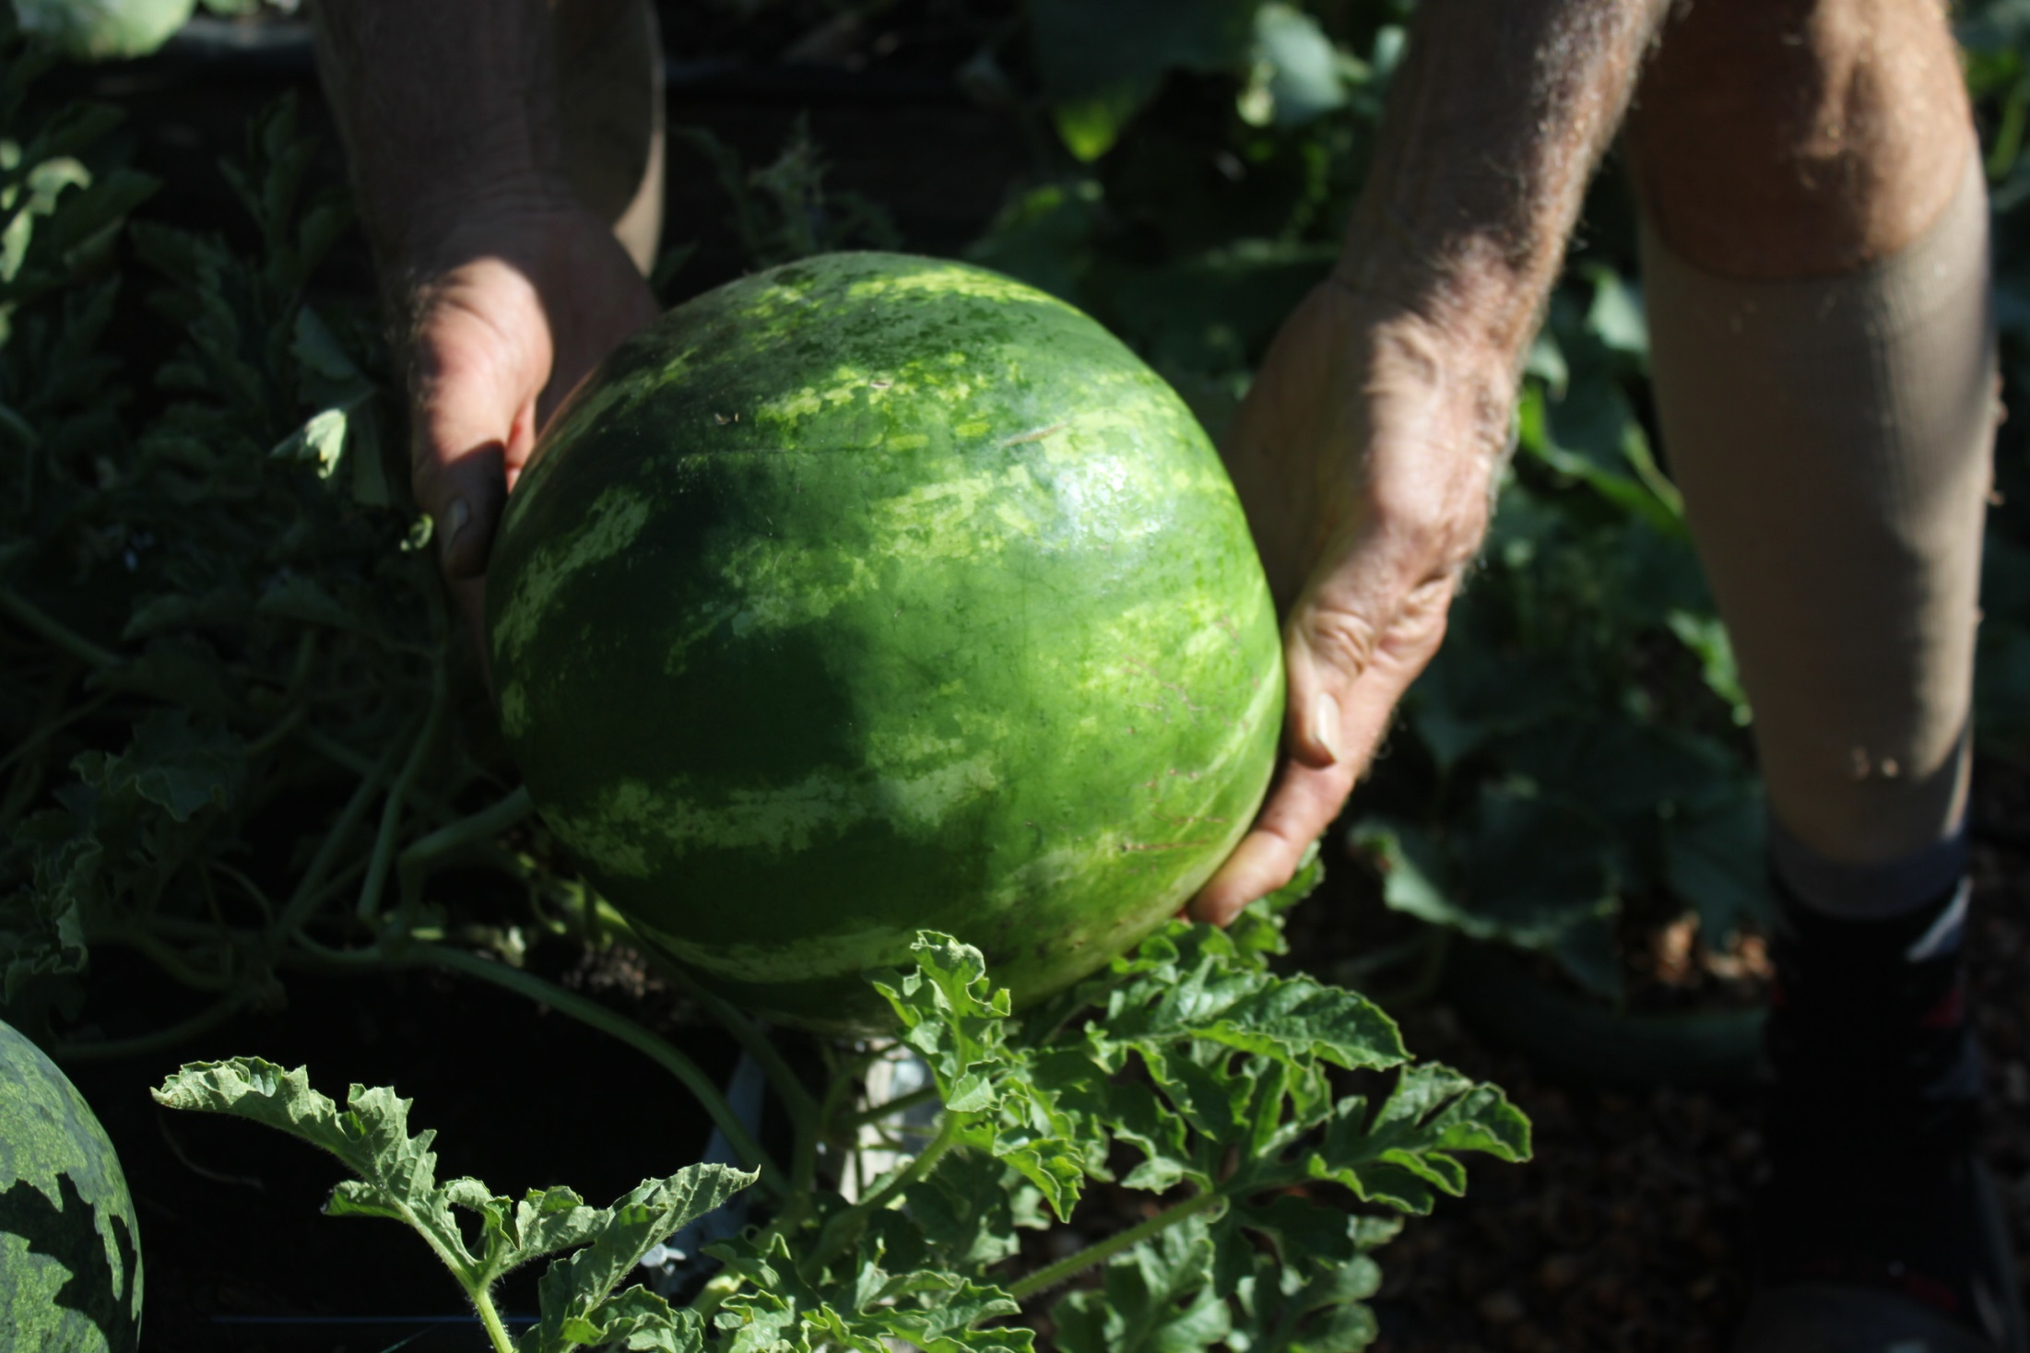

Slide 57
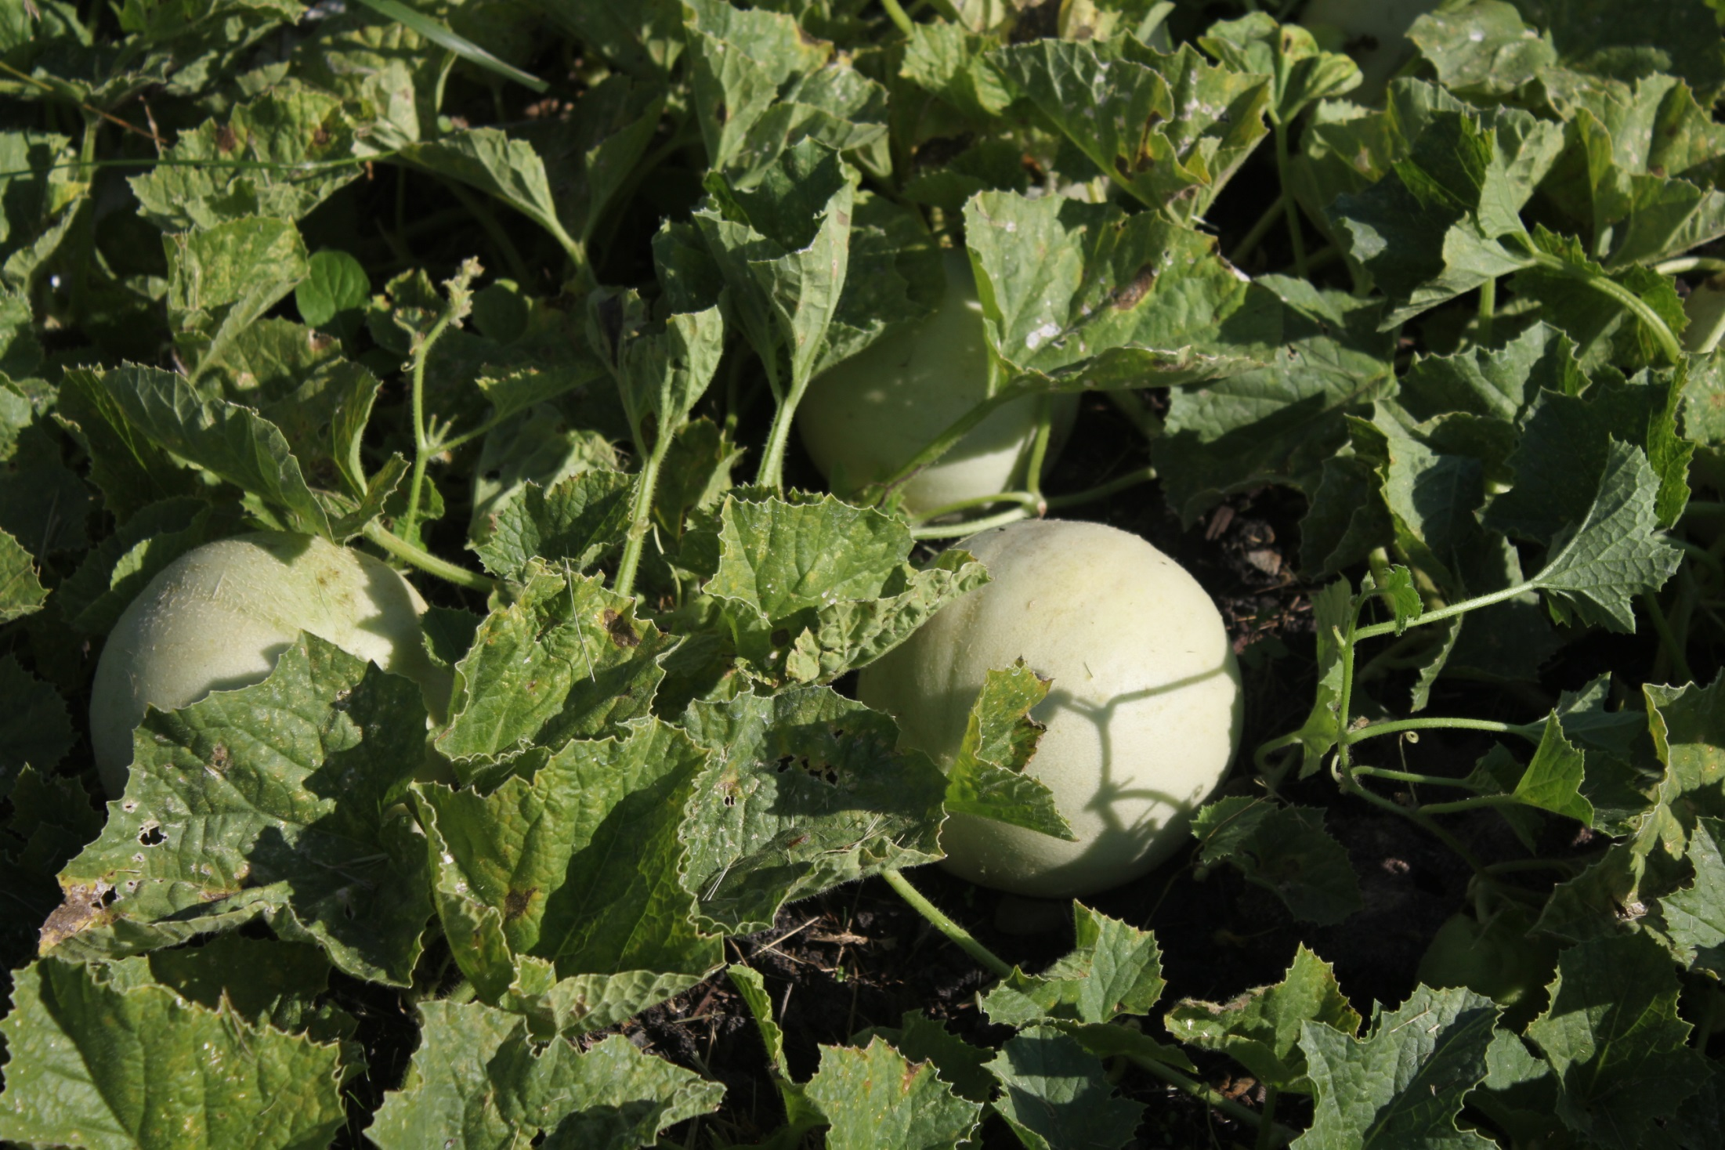
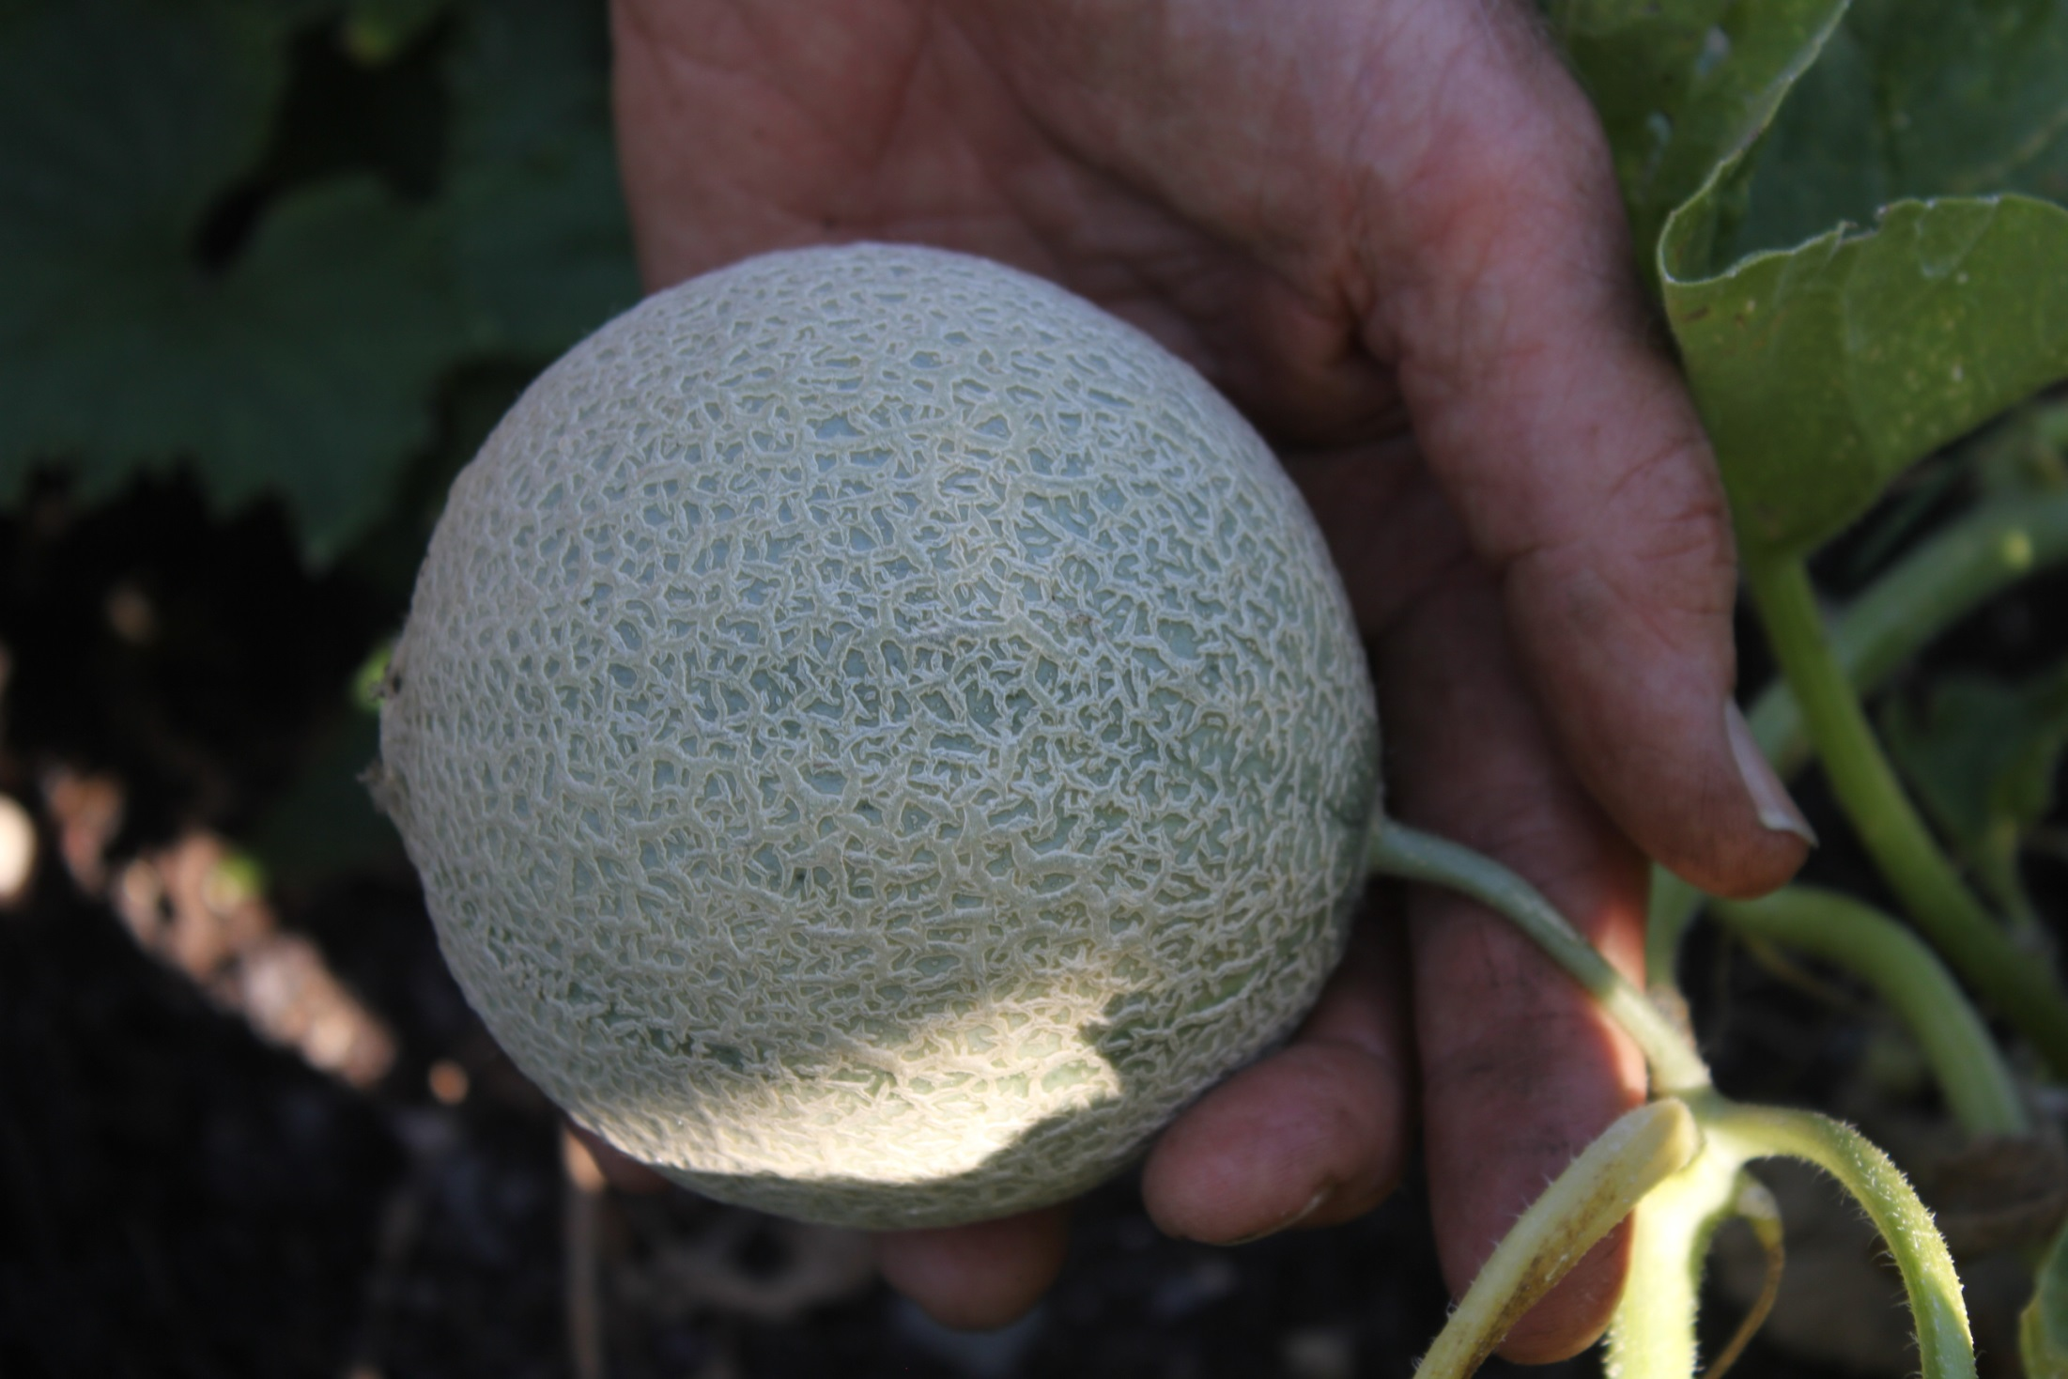

Slide 58
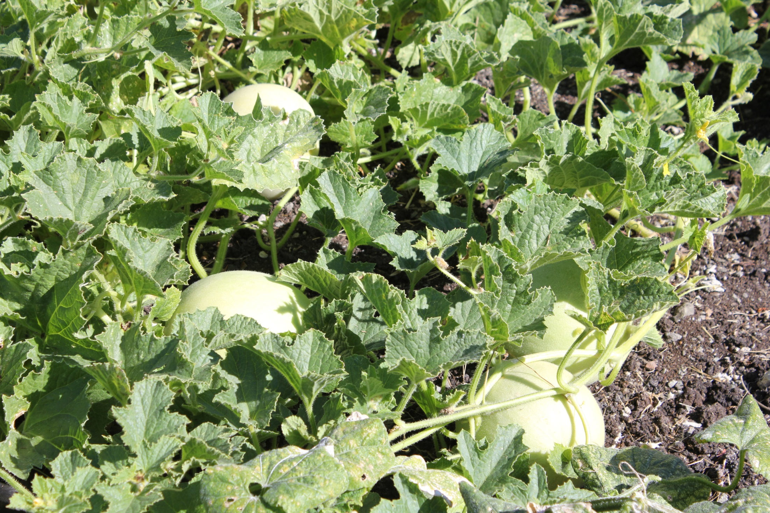

Slide 64
2019 cabbages—planted in February

Slide 66
Fall planting of
Peas (left)
Beets (center)
Cilantro (rear)
Spinach (right)
Swiss Chard
(back right)

Slide 67
Carrots planted mid-July
Planted mid-July, cover with straw, put plastic cover, enjoy all winter

Slide 68
Same carrots, mid-October

Slide 69
Asparagus planted in 2016
(it’s a perennial)

Slide 70
Asparagus in September—gone to seed
Note young cabbage—fall planting

Slide 75
Beer anyone?
Hops.

Slide 76
Herb Garden: parsley, chives, oregano, thyme, sage, rosemary

Slide 77
August

Slide 78
October—protecting tomatoes, strawberries, peppers, tomatillos, eggplants from rain

Slide 79
December—
Fall planted
peas, beets,
spinach,
Swiss chard,
cilantro

Slide 80
January 2018—Carrot Bed w/straw. (also a favorite place for stripe to sleep)

Slide 82
Garlic planted on
Halloween under
a “tunnel”
Carrots were
under straw in
background.

Slide 83
Garlic planted Halloween, but planted uncovered.

Slide 84
Swiss Chard overwintering without protection.

Slide 85
Overwintering
Cabbage without
protection.

Slide 86
January 2019; harvest
of winter carrots and
parsnips

Slide 87
Polycarbonate wall south facing end of barn. Basil, cilantro, lettuce, spinach, Swiss chard

Slide 88
Urban Farming
Farming the space between the sidewalk and the street at our former
home on 23rd Street.

Slide 89
This 7’
space in
front of my
old house
is simply
Wasted.
So I put
raised beds
there.
11 beds
about
5’ X 10’
each.

Slide 90
4’
X
10’
T
a
t
e
r
s

Slide 91
120 pound potato harvest in 2012

Slide 92
Squash/Pumpkins & Melons

Slide 93
Street View Squash/Pumpkins and Melons

Slide 94
Green Beans/Sweet Potatoes

Slide 95
6’ X 15’ sweet potato bed in 2015

Slide 96
Same bed produced
125 pounds of
sweet potatoes in
2015

Slide 97
Sweet Potatoes must cure at a warm
Temperature for three weeks.

Slide 98
Container Gardening
Live in an apartment? Short on space? No garden plots available? No problem. Buy a 5 gallon bucket , fill it with potting soil and go for it!
Also Gardener’s Supply has lots of containers.
Don’t forget that you need 6+ hours of sunshine for most vegetables.

Slide 99
Garden shed made from
used fence boards from
Habitat for Humanity
Restore.

